Slide 1
COMP 4500
Week 15 - Wednesday

Slide 2
Last time
What did we talk about last time?
Review of second third of course
  Recurrence relations
  Divide and conquer
    Counting inversions
    Closest pair of points
    Integer multiplication
  Master theorem
  Dynamic programming
    Weighted interval scheduling
    Subset sum
    Knapsack
    Sequence alignment

Slide 3
Questions?

Slide 4
Assignment 7

Slide 5
Logical warmup
Each of the following equations is made of matches and written using Roman numerals
Unfortunately, each equation is wrong
Move a single match stick in each equation to correct the error
  VI = IV – III (12 matches)
  XIV – V = XX (14 matches)
  X = VIII – II (12 matches)
  VII = I (7 matches but bizarre)

Slide 6
Review

Slide 7
Final exam
Final exam:
  Friday, April 24, 2026
  10:15 a.m. – 12:15 p.m.
It will mostly be short answer
There will be diagrams
There might be a matching problem
There will likely be a (simple) proof
It will be 50% longer than previous exams, but you will have 100% more time

Slide 8
Maximum Flow

Slide 9
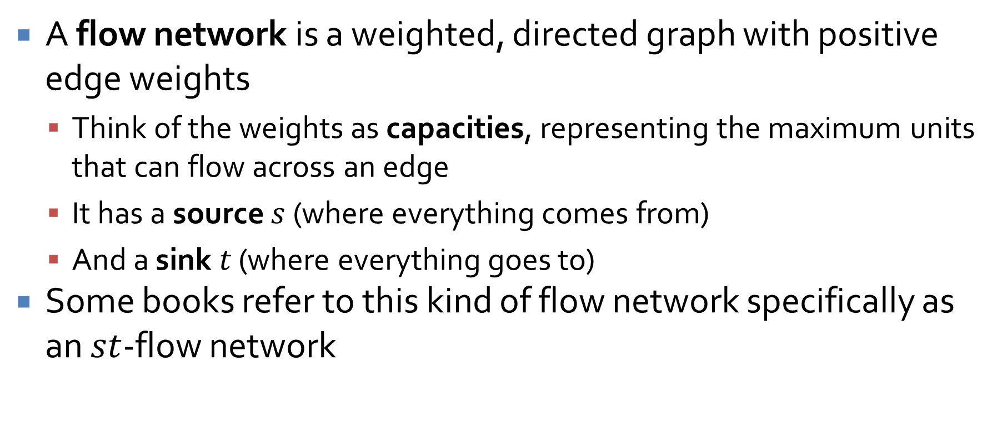
Flow networks
A flow network is a weighted, directed graph with positive edge weights
  Think of the weights as capacities, representing the maximum units that can flow across an edge
  It has a source $s$ (where everything comes from)
  And a sink $t$ (where everything goes to)
Some books refer to this kind of flow network specifically as an $st$-flow network

Slide 10
Maximum flow
A common flow problem is to find the maximum flow
A maximum flow is a flow such that the amount leaving s and the amount going into t is as large as possible
In other words:
  The maximum amount of flow gets from s to t
  No edge has more flow than its capacity
  The flow going into every node (except s and t) is equal to the flow going out

Slide 11
Flow network
4
a
b
5
3
3
7
4
7
s
c
d
t
6
1
4
6
e
f
5

Slide 12
Ford-Fulkerson algorithm
Ford-Fulkerson is a family of algorithms for finding the maximum flow
Start with zero flow on all edges
Find an augmenting path (increasing flow on forward edges and decreasing flow on backwards edges)
If you can still find an augmenting path in the residual graph, go back to Step 2

Slide 13
Bipartite Matching

Slide 14
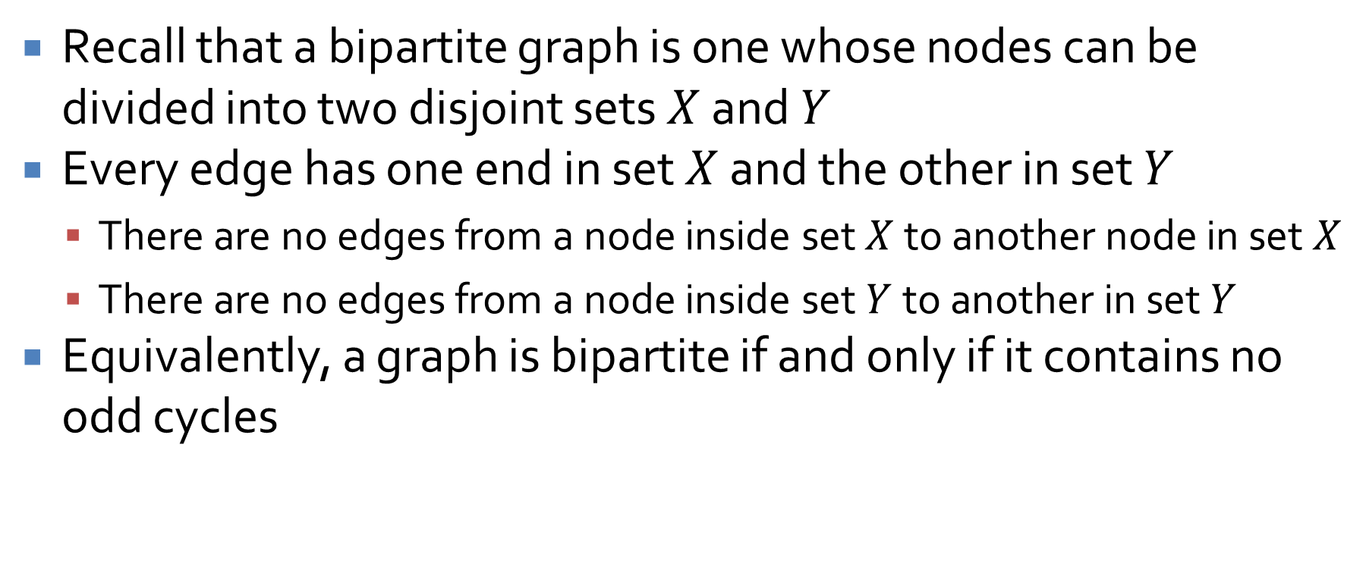
Bipartite graphs
Recall that a bipartite graph is one whose nodes can be divided into two disjoint sets $X$ and $Y$
Every edge has one end in set $X$ and the other in set $Y$
  There are no edges from a node inside set $X$ to another node in set $X$
  There are no edges from a node inside set $Y$ to another in set $Y$
Equivalently, a graph is bipartite if and only if it contains no odd cycles

Slide 15
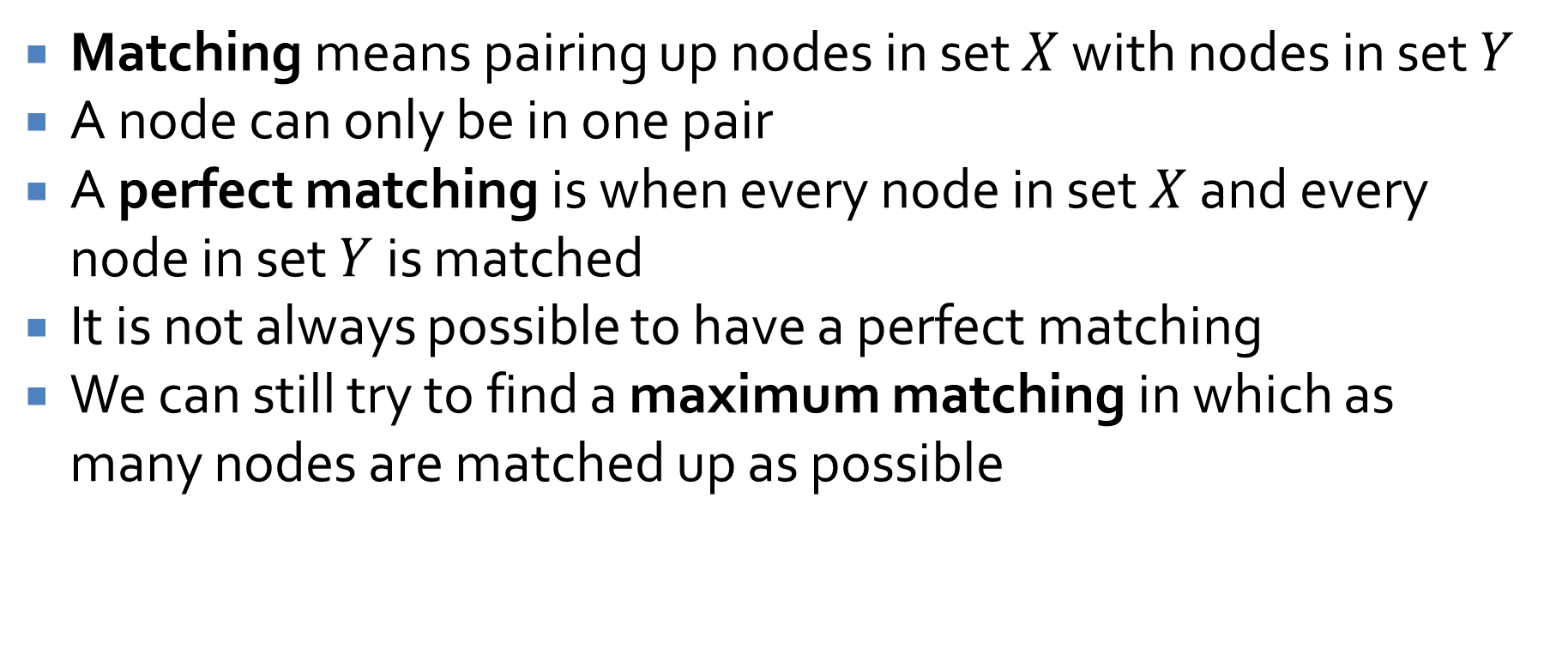
Maximum matching
Matching means pairing up nodes in set $X$ with nodes in set $Y$
A node can only be in one pair
A perfect matching is when every node in set $X$ and every node in set $Y$ is matched
It is not always possible to have a perfect matching
We can still try to find a maximum matching in which as many nodes are matched up as possible

Slide 16
Bipartite matching problem
X
A
B
C
D
E
F
Y
G
H
I
J
K
L

Slide 17
Maximum flow problem
s
X
A
B
C
D
E
F
Y
G
H
I
J
K
L
t

Slide 18
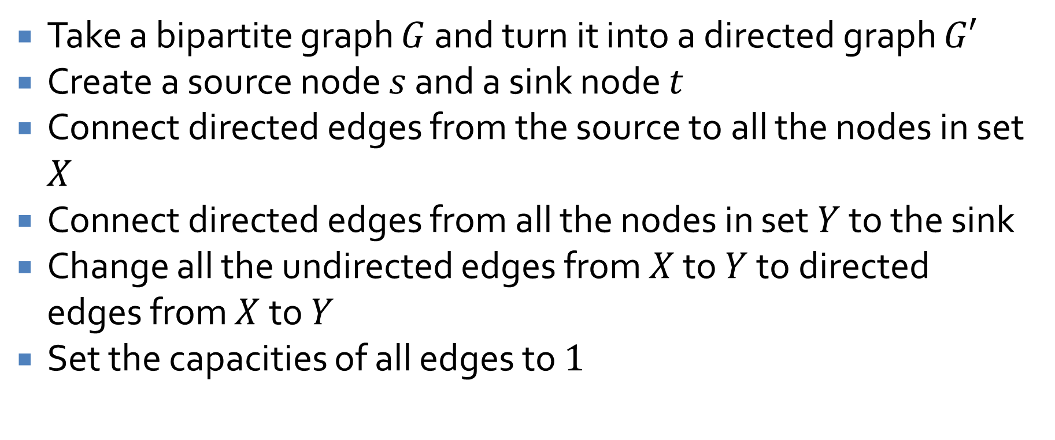
An easy change
Take a bipartite graph $G$ and turn it into a directed graph $G′$
Create a source node $s$ and a sink node $t$
Connect directed edges from the source to all the nodes in set $X$
Connect directed edges from all the nodes in set $Y$ to the sink
Change all the undirected edges from $X$ to $Y$ to directed edges from $X$ to $Y$
Set the capacities of all edges to $1$

Slide 19
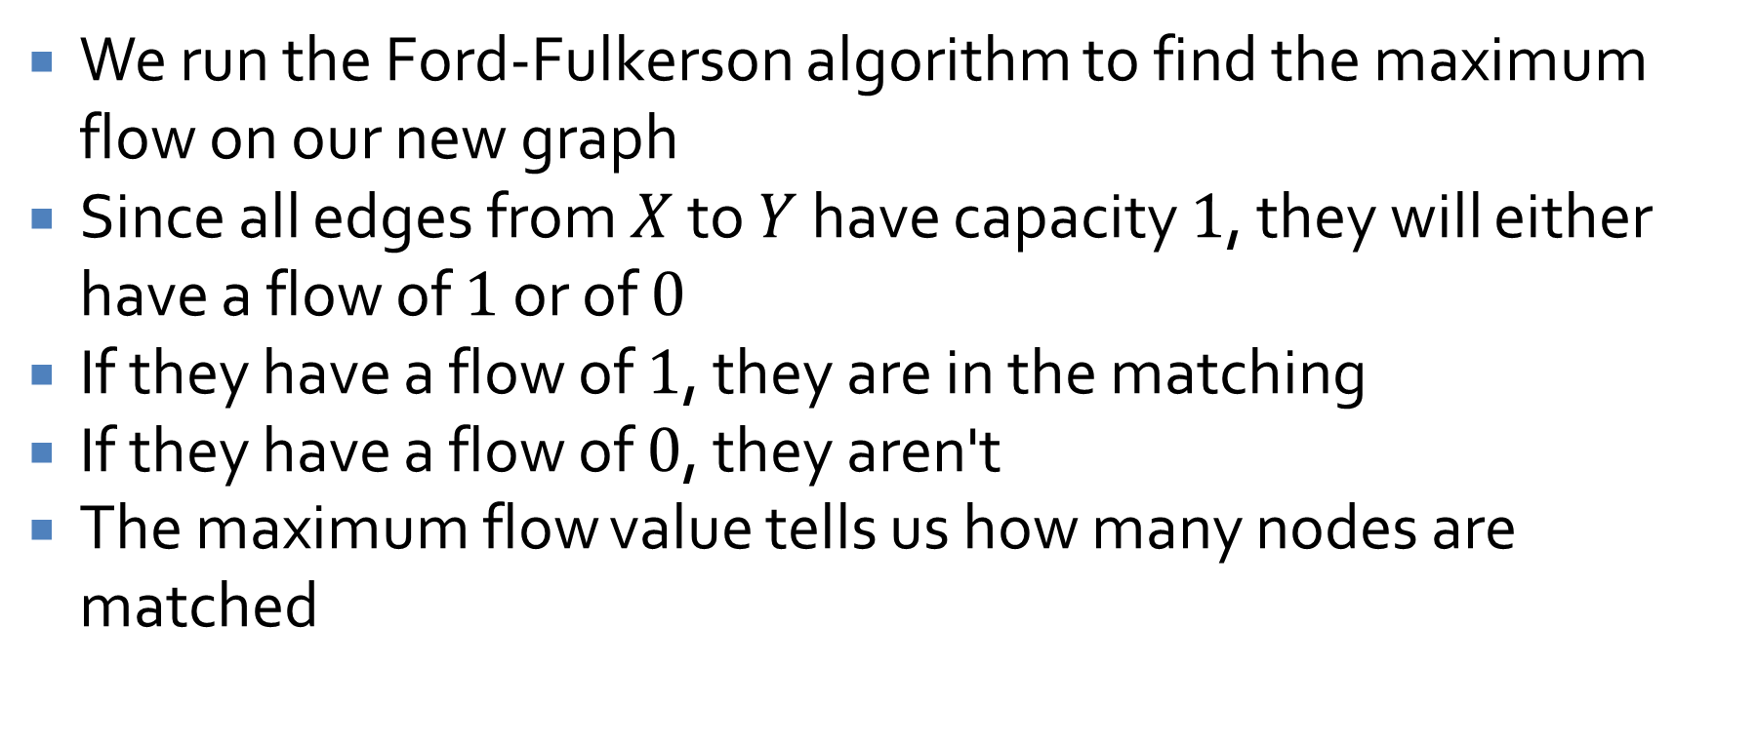
Algorithmic changes
We run the Ford-Fulkerson algorithm to find the maximum flow on our new graph
Since all edges from $X$ to $Y$ have capacity $1$, they will either have a flow of $1$ or of $0$
If they have a flow of $1$, they are in the matching
If they have a flow of $0$, they aren't
The maximum flow value tells us how many nodes are matched

Slide 20
Maximal matching
To make the algorithm go faster, we can start with a maximal matching
A maximal matching is not necessarily maximum, but you can't add edges to it directly without removing other edges
In essence, arbitrarily match unmatched nodes until you can't anymore
Then start the process of looking for augmenting paths

Slide 21
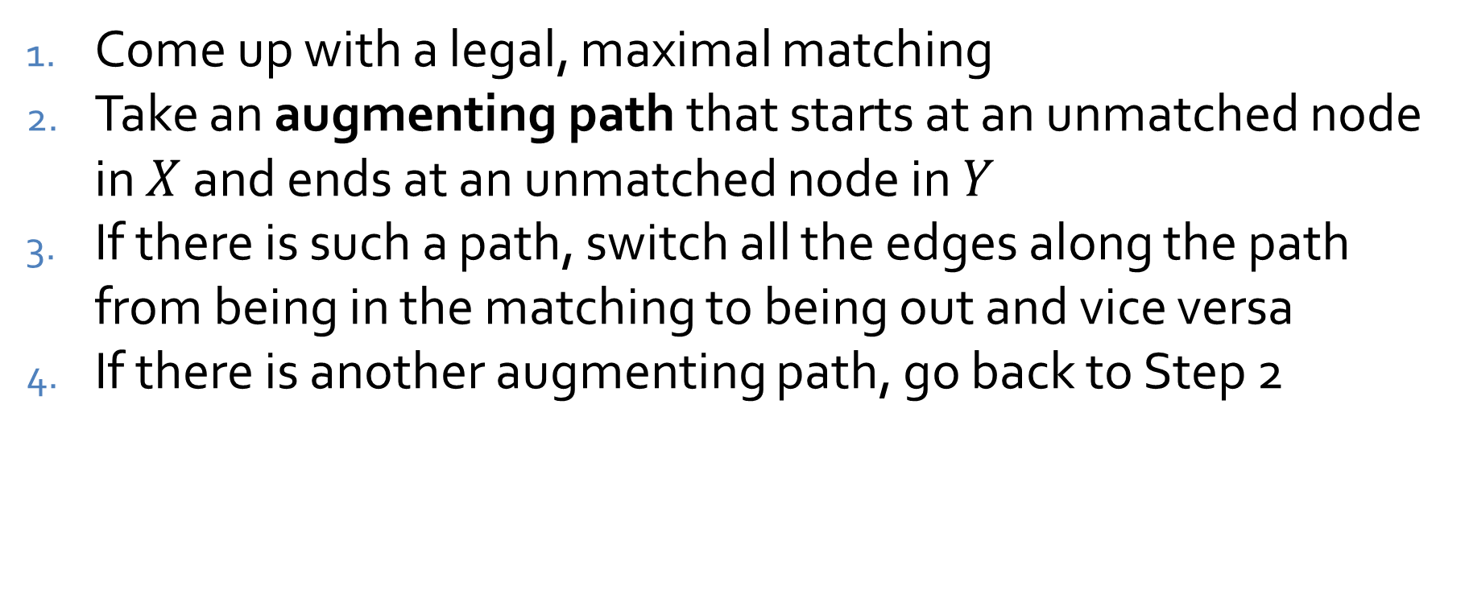
Matching algorithm
Come up with a legal, maximal matching
Take an augmenting path that starts at an unmatched node in $X$ and ends at an unmatched node in $Y$
If there is such a path, switch all the edges along the path from being in the matching to being out and vice versa
If there is another augmenting path, go back to Step 2

Slide 22
NP-Completeness

Slide 23
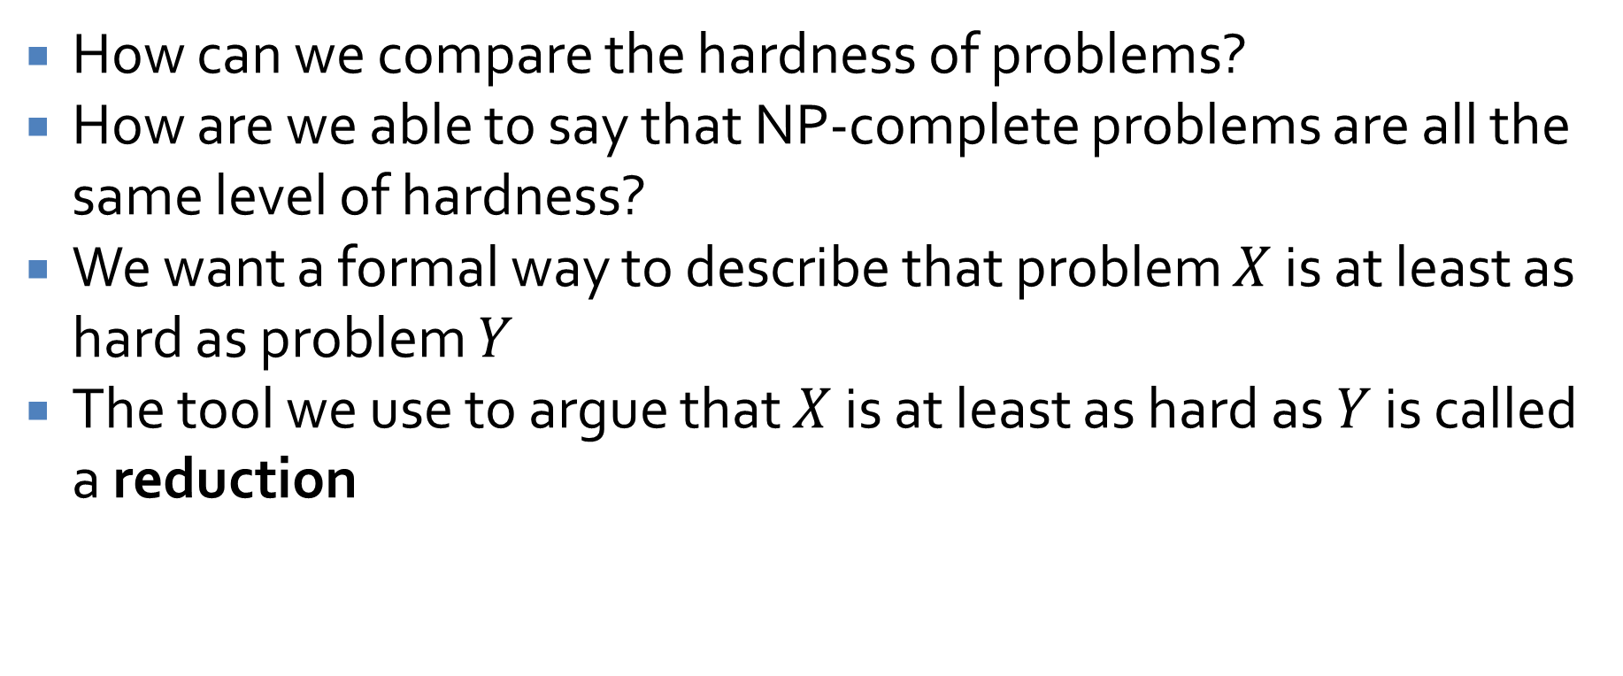
Characterizing hardness
How can we compare the hardness of problems?
How are we able to say that NP-complete problems are all the same level of hardness?
We want a formal way to describe that problem $X$ is at least as hard as problem $Y$
The tool we use to argue that $X$ is at least as hard as $Y$ is called a reduction

Slide 24
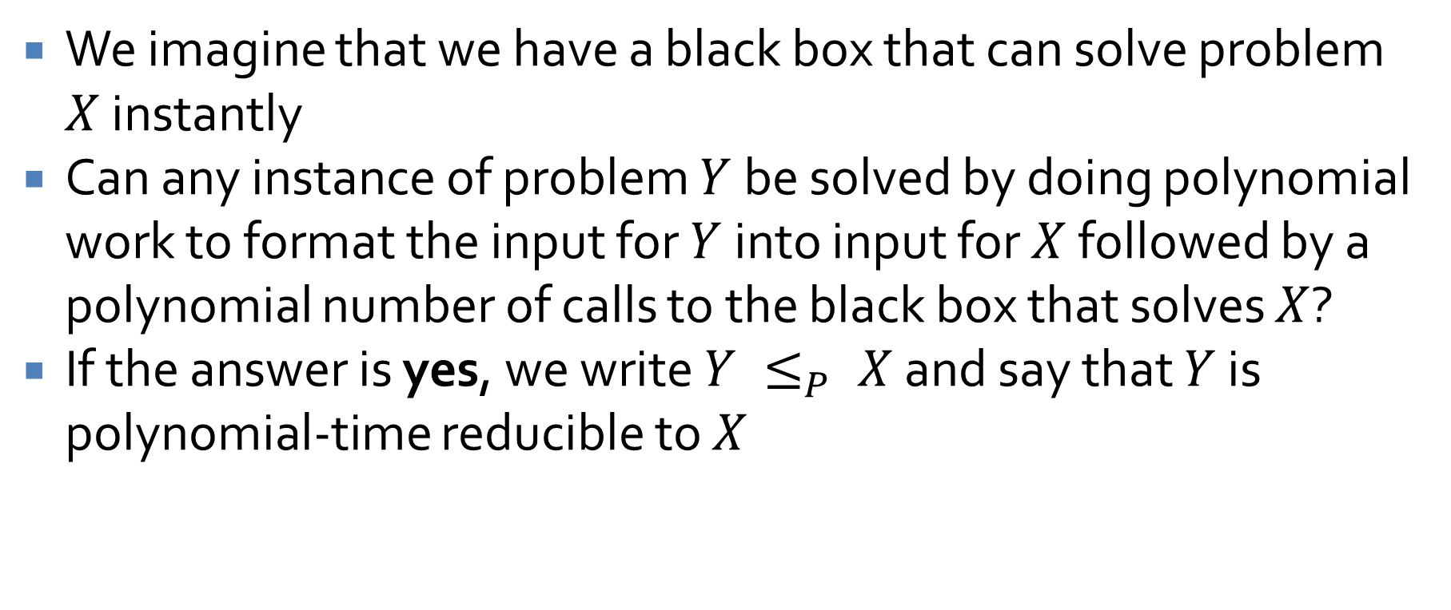
Reductions
We imagine that we have a black box that can solve problem $X$ instantly
Can any instance of problem $Y$ be solved by doing polynomial work to format the input for $Y$ into input for $X$ followed by a polynomial number of calls to the black box that solves $X$?
If the answer is yes, we write $Y ≤_{P} X$ and say that $Y$ is polynomial-time reducible to $X$

Slide 25
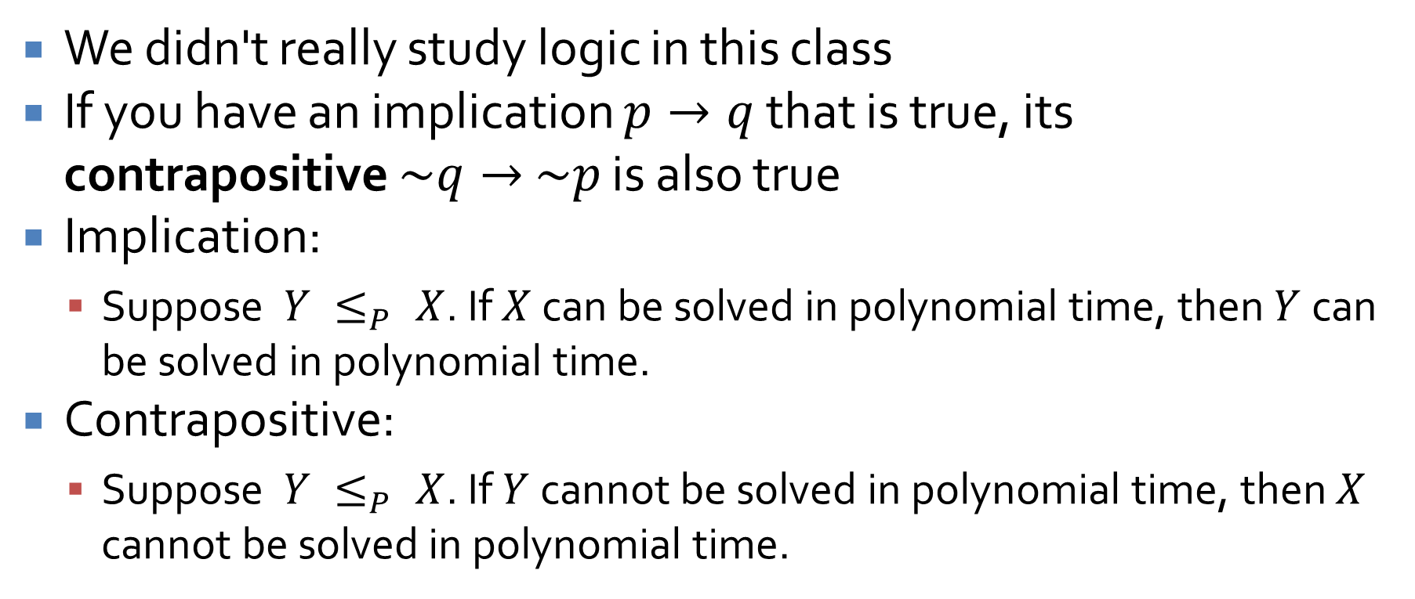
What about the other direction?
We didn't really study logic in this class
If you have an implication $p→q$ that is true, its contrapositive $\sim q→$ $\sim p$ is also true
Implication:
  Suppose $Y ≤_{P} X$. If $X$ can be solved in polynomial time, then $Y$ can be solved in polynomial time.
Contrapositive:
  Suppose $Y ≤_{P} X$. If $Y$ cannot be solved in polynomial time, then $X$ cannot be solved in polynomial time.

Slide 26
Independent set
Recall the independent set graph problem
Given an undirected graph, find the largest collection of nodes that are not connected to each other
Practical application:
  Nodes represent friends of yours
  An edge between those two nodes means they hate each other
  What's the largest group of friends you could invite to a party if you don't want any to hate each other?

Slide 27
Independent set example
A
G
B
H
E
F
C
D

Slide 28
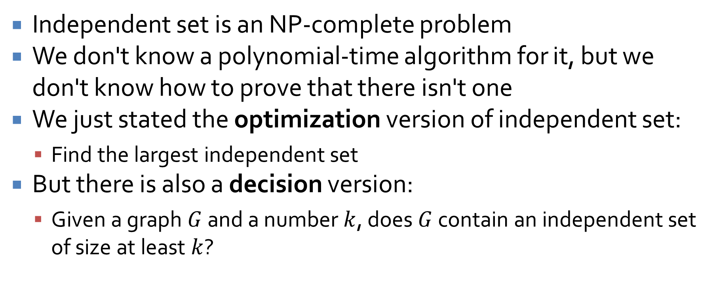
Hardness of independent set
Independent set is an NP-complete problem
We don't know a polynomial-time algorithm for it, but we don't know how to prove that there isn't one
We just stated the optimization version of independent set:
  Find the largest independent set
But there is also a decision version:
  Given a graph $G$ and a number $k$, does $G$ contain an independent set of size at least $k$?

Slide 29
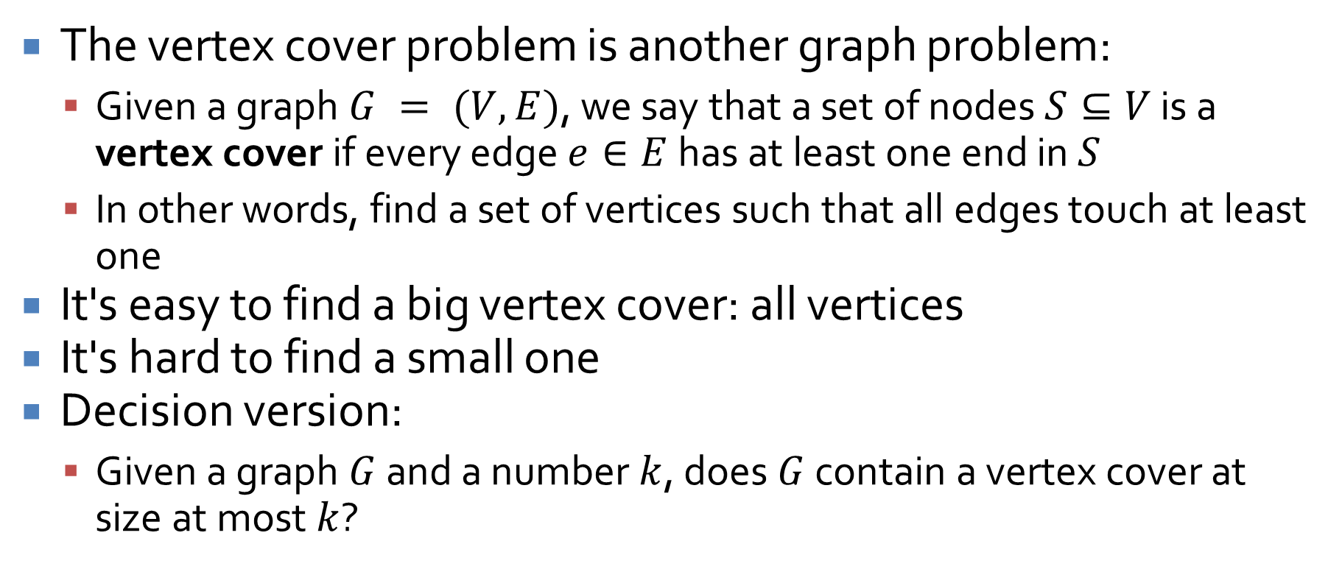
Vertex cover
The vertex cover problem is another graph problem:
  Given a graph $G = (V, E)$, we say that a set of nodes $S⊆V$ is a vertex cover if every edge $e∈E$ has at least one end in $S$
  In other words, find a set of vertices such that all edges touch at least one
It's easy to find a big vertex cover: all vertices
It's hard to find a small one
Decision version:
  Given a graph $G$ and a number $k$, does $G$ contain a vertex cover at size at most $k$?

Slide 30
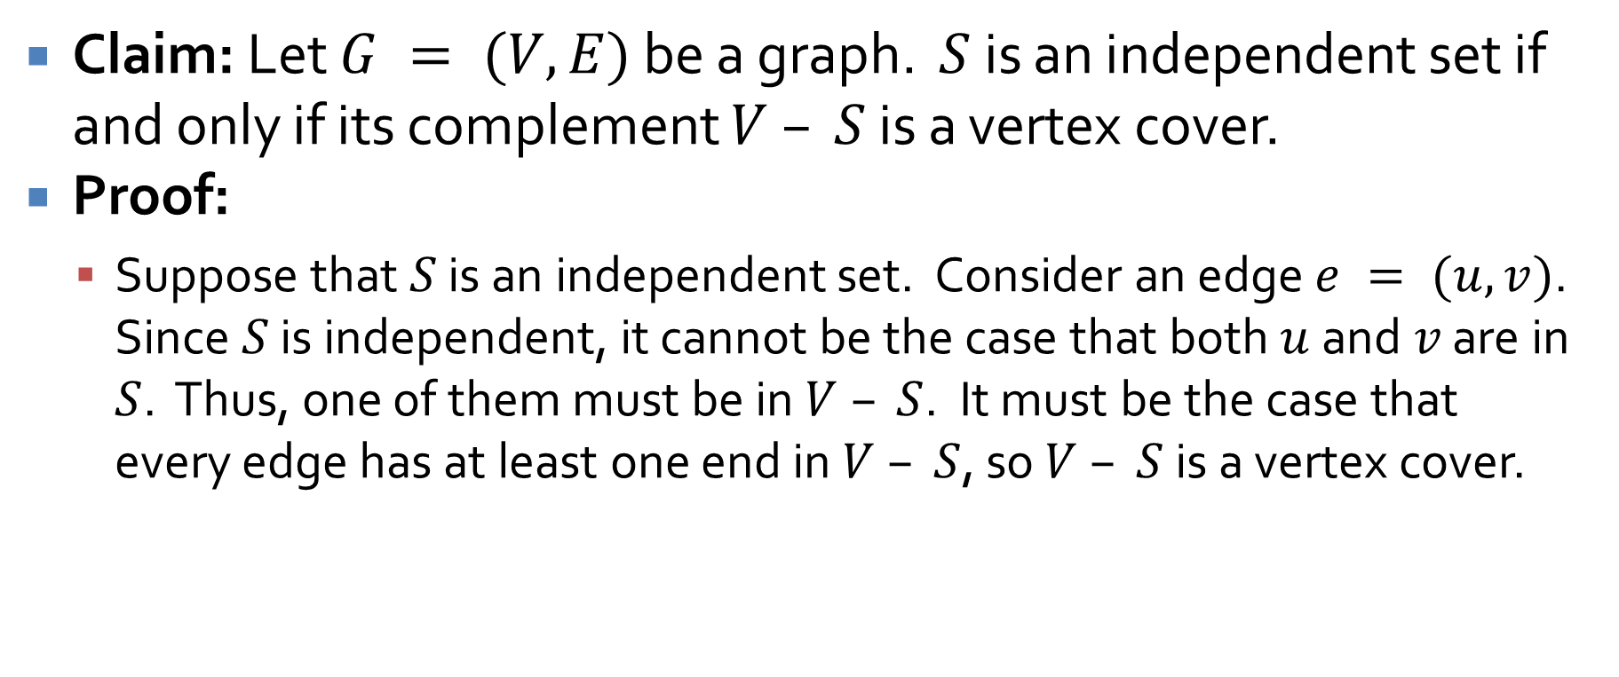
Relationship between independent set and vertex cover
Claim: Let $G = (V,E)$ be a graph. $S$ is an independent set if and only if its complement $V – S$ is a vertex cover.
Proof:
  Suppose that $S$ is an independent set. Consider an edge $e = (u,v)$. Since $S$ is independent, it cannot be the case that both $u$ and $v$ are in $S$. Thus, one of them must be in $V – S$. It must be the case that every edge has at least one end in $V – S$, so $V – S$ is a vertex cover.

Slide 31
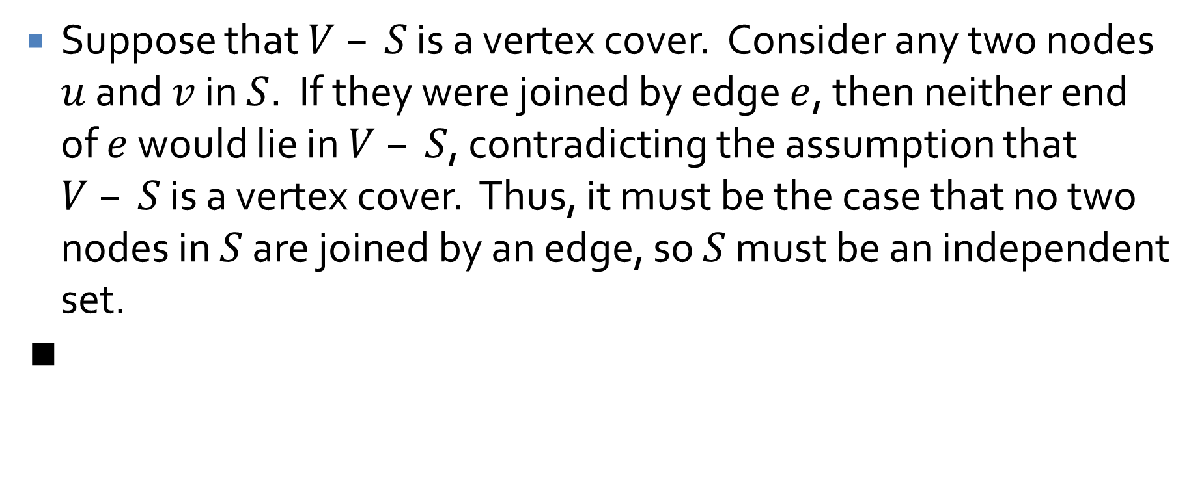
Proof continued
Suppose that $V – S$ is a vertex cover. Consider any two nodes $u$ and $v$ in $S$. If they were joined by edge $e$, then neither end of $e$ would lie in $V – S$, contradicting the assumption that $V – S$ is a vertex cover. Thus, it must be the case that no two nodes in $S$ are joined by an edge, so $S$ must be an independent set.
∎

Slide 32
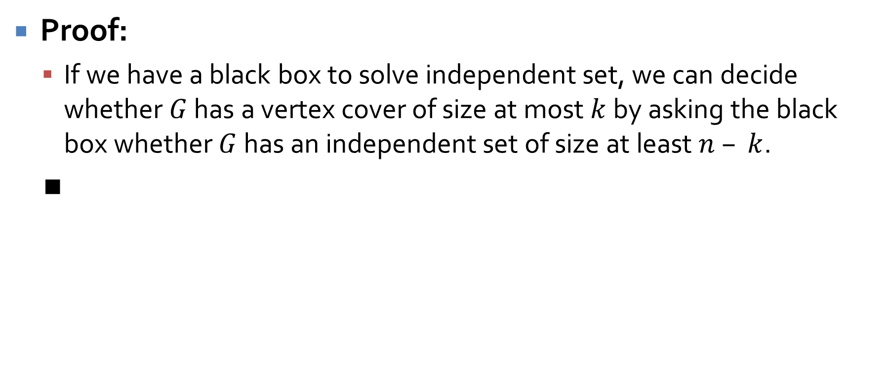

Vertex cover $≤_{P}$ independent set
Proof:
  If we have a black box to solve independent set, we can decide whether $G$ has a vertex cover of size at most $k$ by asking the black box whether $G$ has an independent set of size at least $n – k$.
  ∎

Slide 33
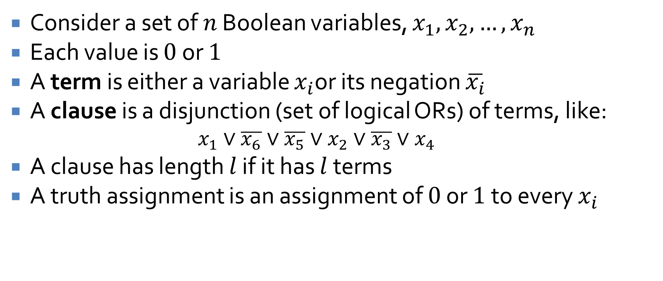
SAT and 3-SAT
Consider a set of $n$ Boolean variables, $x_{1}, x_{2}, …, x_{n}$
Each value is $0$ or $1$
A term is either a variable $x_{i}$or its negation $\overline{x_{i}}$
A clause is a disjunction (set of logical ORs) of terms, like:
  $$x_{1}∨\overline{x_{6}}∨\overline{x_{5}}∨x_{2}∨\overline{x_{3}}∨x_{4}$$
A clause has length $l$ if it has $l$ terms
A truth assignment is an assignment of $0$ or $1$ to every $x_{i}$

Slide 34
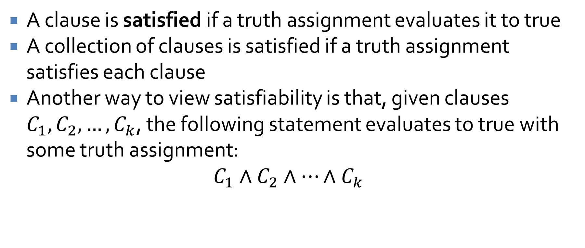
Satisfiability
A clause is satisfied if a truth assignment evaluates it to true
A collection of clauses is satisfied if a truth assignment satisfies each clause
Another way to view satisfiability is that, given clauses $C_{1}, C_{2}, …, C_{k}$, the following statement evaluates to true with some truth assignment:
$$C_{1}∧C_{2}∧…∧C_{k}$$

Slide 35
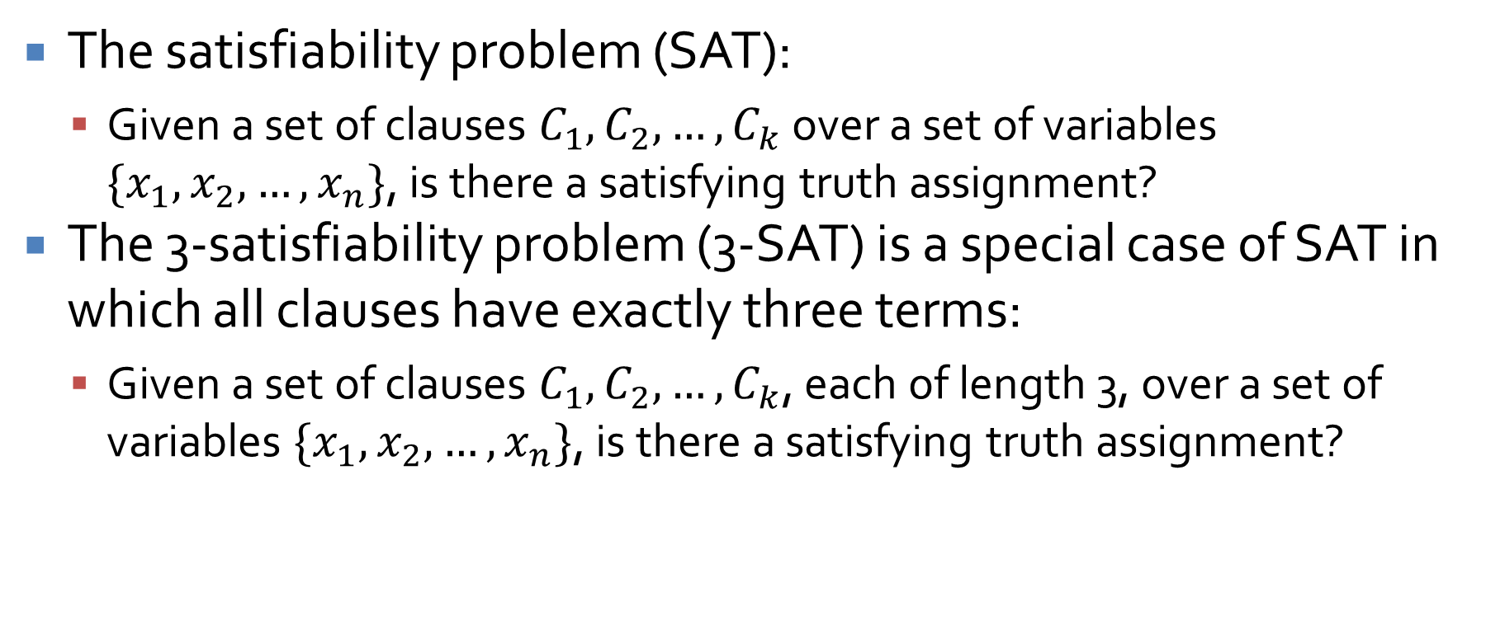
Satisfiability
The satisfiability problem (SAT):
  Given a set of clauses $C_{1}, C_{2}, …, C_{k}$ over a set of variables $\{x_{1}, x_{2}, …, x_{n}\}$, is there a satisfying truth assignment?
The 3-satisfiability problem (3-SAT) is a special case of SAT in which all clauses have exactly three terms:
  Given a set of clauses $C_{1}, C_{2}, …, C_{k}$, each of length 3, over a set of variables $\{x_{1}, x_{2}, …, x_{n}\}$, is there a satisfying truth assignment?

Slide 36
What makes a problem NP?
Is there something that sets apart problems that are NP-complete from other problems that (probably) take exponential time?
Yes!
It's easy to prove that you have an answer for one
In other words, they're easy to check

Slide 37
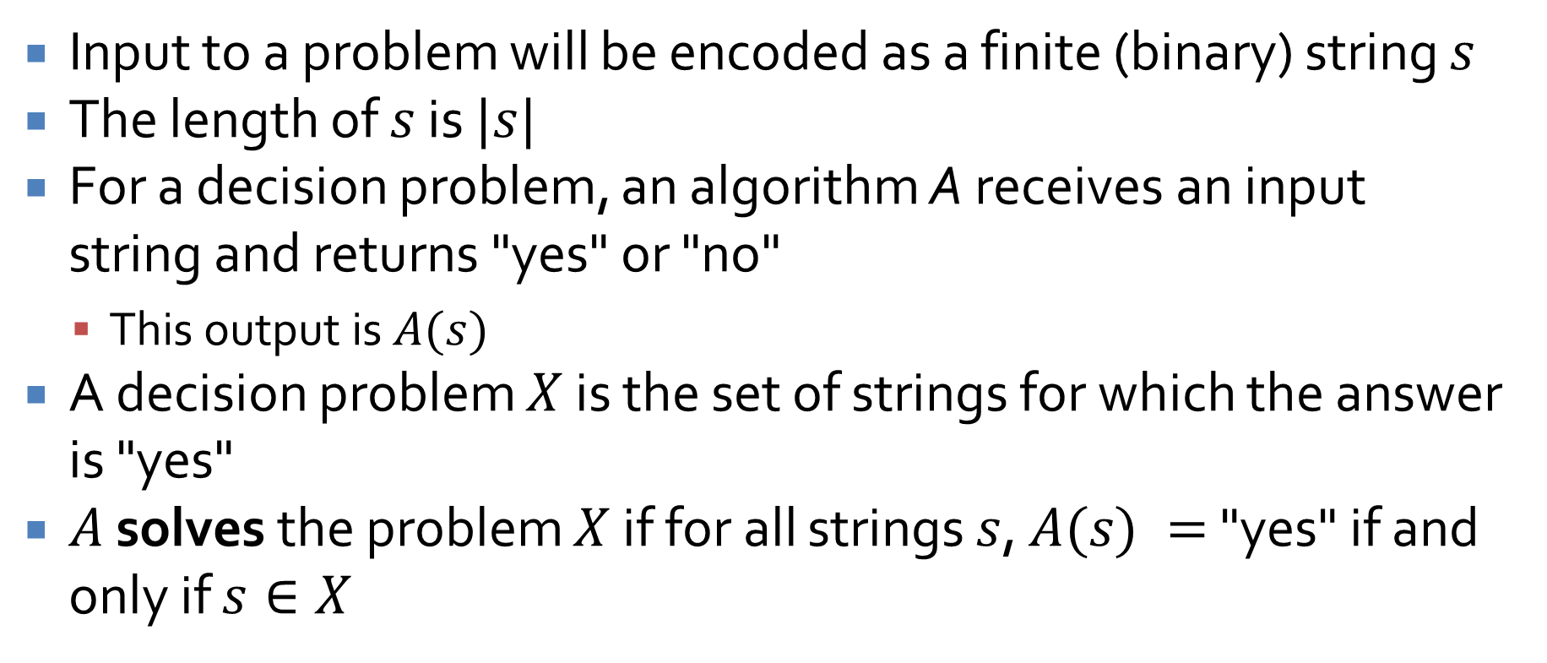
Problems and algorithms
Input to a problem will be encoded as a finite (binary) string $s$
The length of $s$ is $|s|$
For a decision problem, an algorithm A receives an input string and returns "yes" or "no"
  This output is $A(s)$
A decision problem $X$ is the set of strings for which the answer is "yes"
$A$ solves the problem $X$ if for all strings $s$, $A(s) =$ "yes" if and only if $s∈X$

Slide 38
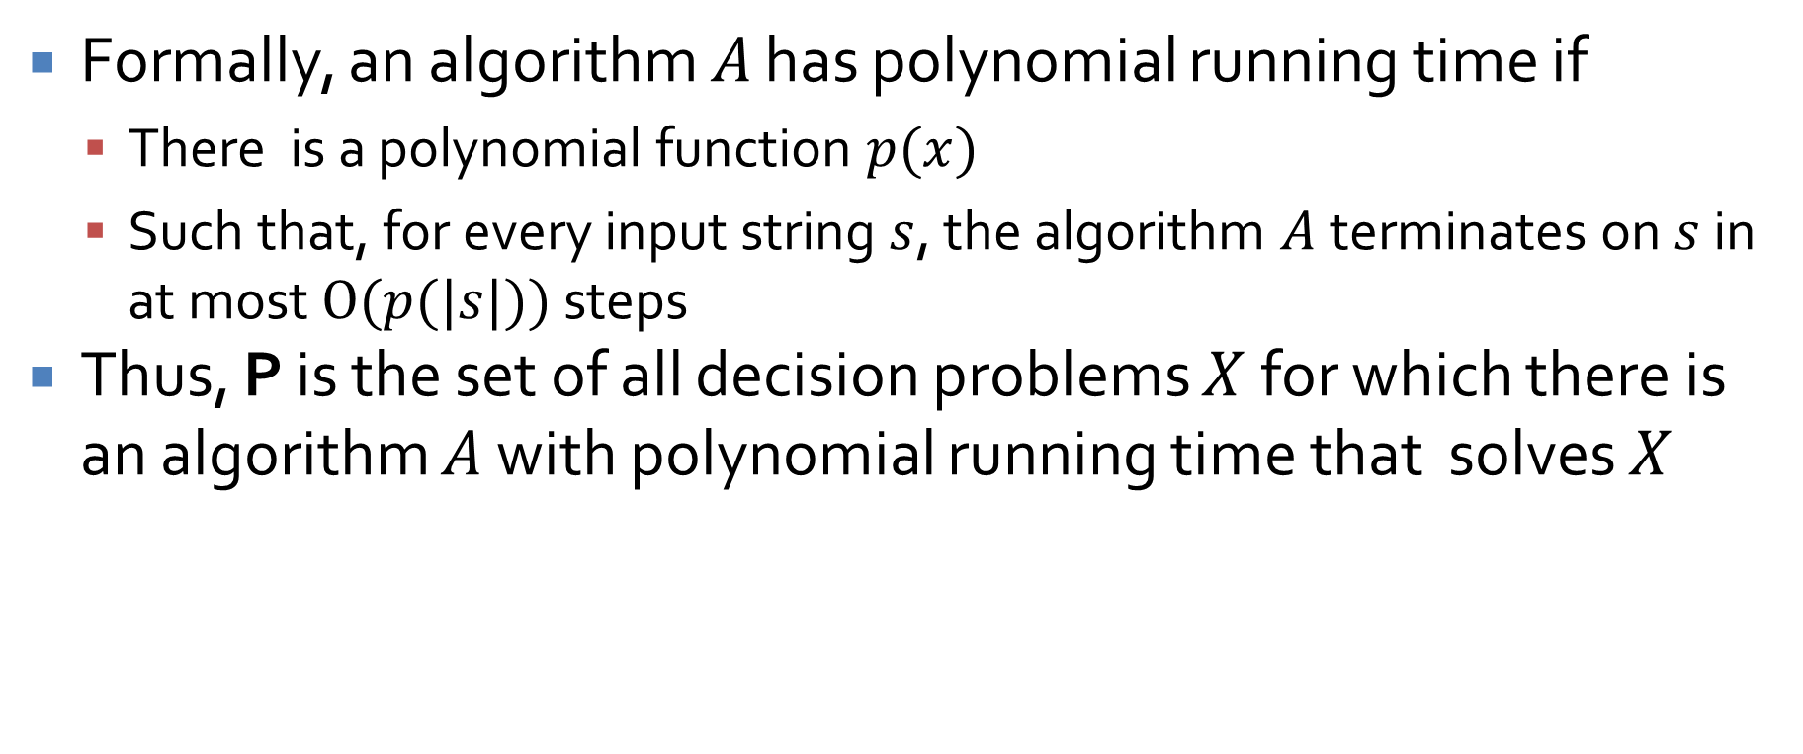
The class of problems P
Formally, an algorithm $A$ has polynomial running time if
  There is a polynomial function $p(x)$
  Such that, for every input string $s$, the algorithm $A$ terminates on $s$ in at most $O(p(|s|))$ steps
Thus, P is the set of all decision problems $X$ for which there is an algorithm $A$ with polynomial running time that solves $X$

Slide 39
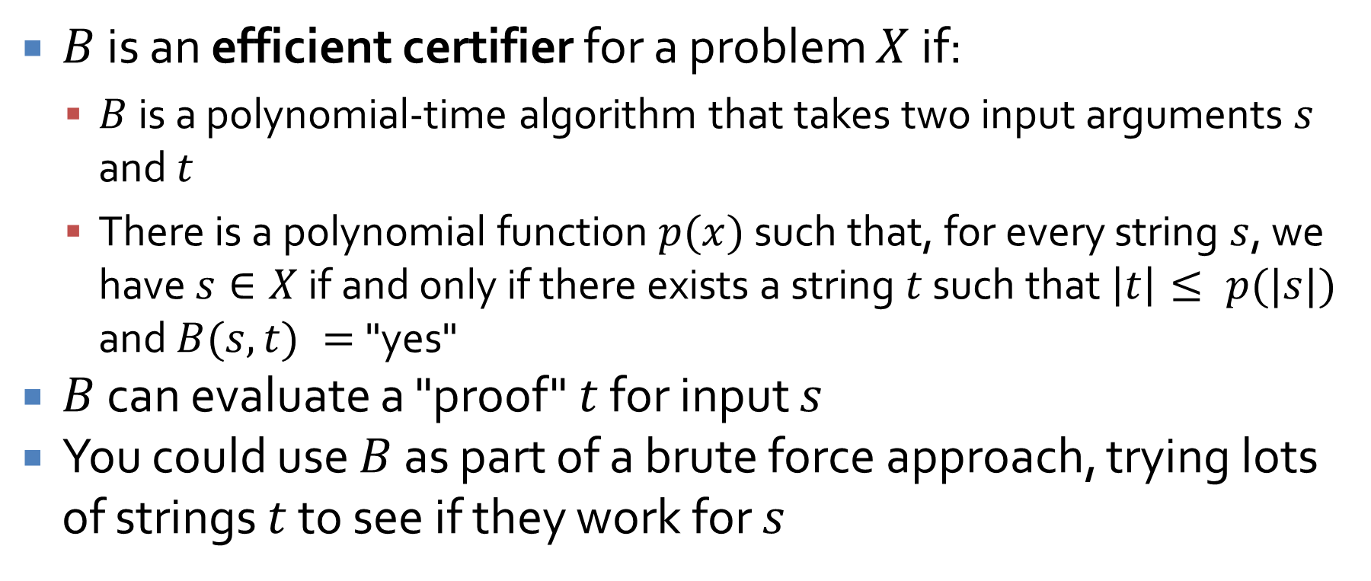
Efficient certification
$B$ is an efficient certifier for a problem $X$ if:
  $B$ is a polynomial-time algorithm that takes two input arguments $s$ and $t$
  There is a polynomial function $p(x)$ such that, for every string $s$, we have $s∈X$ if and only if there exists a string $t$ such that $\left|t\right|≤ p(|s|)$ and $B(s,t) =$"yes"
$B$ can evaluate a "proof" $t$ for input $s$
You could use $B$ as part of a brute force approach, trying lots of strings $t$ to see if they work for $s$

Slide 40
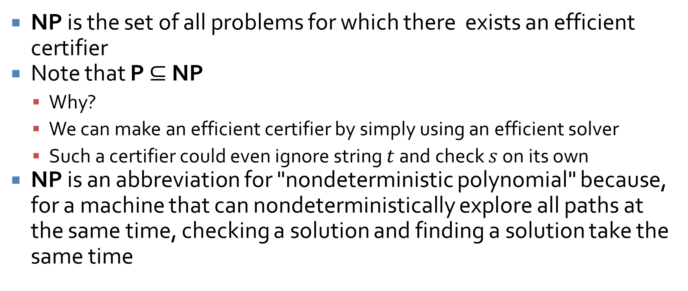
The class of problems NP
NP is the set of all problems for which there exists an efficient certifier
Note that P $⊆$ NP
  Why?
  We can make an efficient certifier by simply using an efficient solver
  Such a certifier could even ignore string $t$ and check $s$ on its own
NP is an abbreviation for "nondeterministic polynomial" because, for a machine that can nondeterministically explore all paths at the same time, checking a solution and finding a solution take the same time

Slide 41
NP-Complete Problems

Slide 42
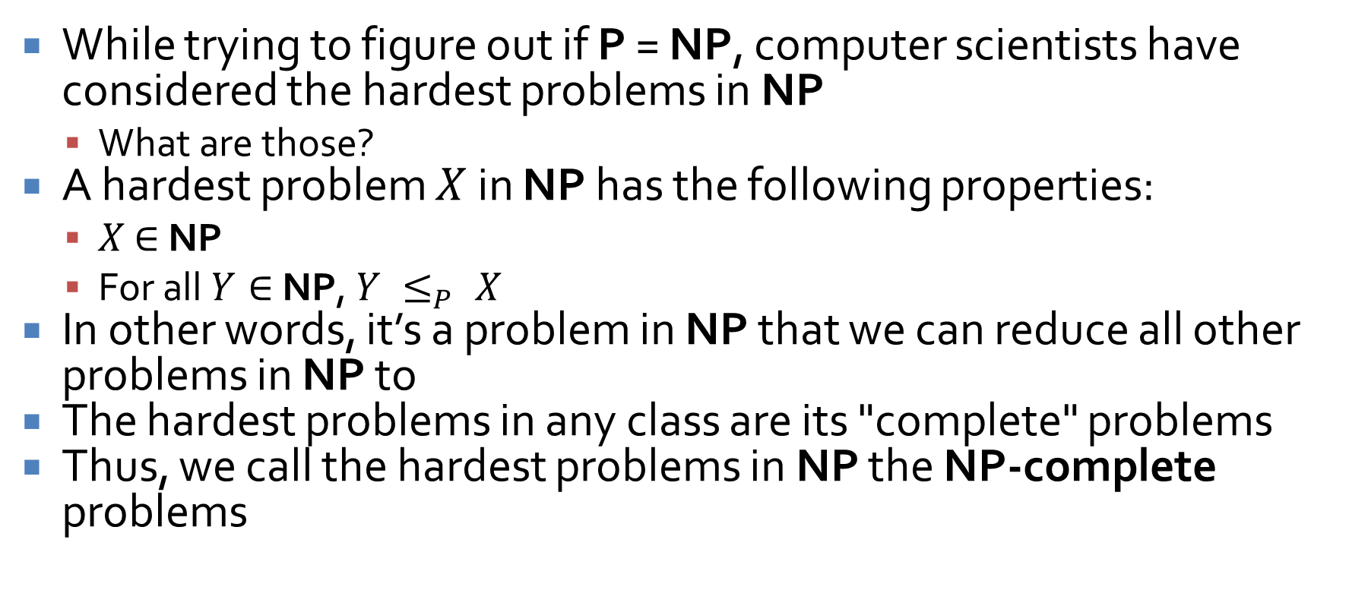
NP-complete problems
While trying to figure out if P = NP, computer scientists have considered the hardest problems in NP
  What are those?
A hardest problem $X$ in NP has the following properties:
  $X$ $∈$ NP
  For all $Y∈$ NP, $Y ≤_{P} X$
In other words, it’s a problem in NP that we can reduce all other problems in NP to
The hardest problems in any class are its "complete" problems
Thus, we call the hardest problems in NP the NP-complete problems

Slide 43
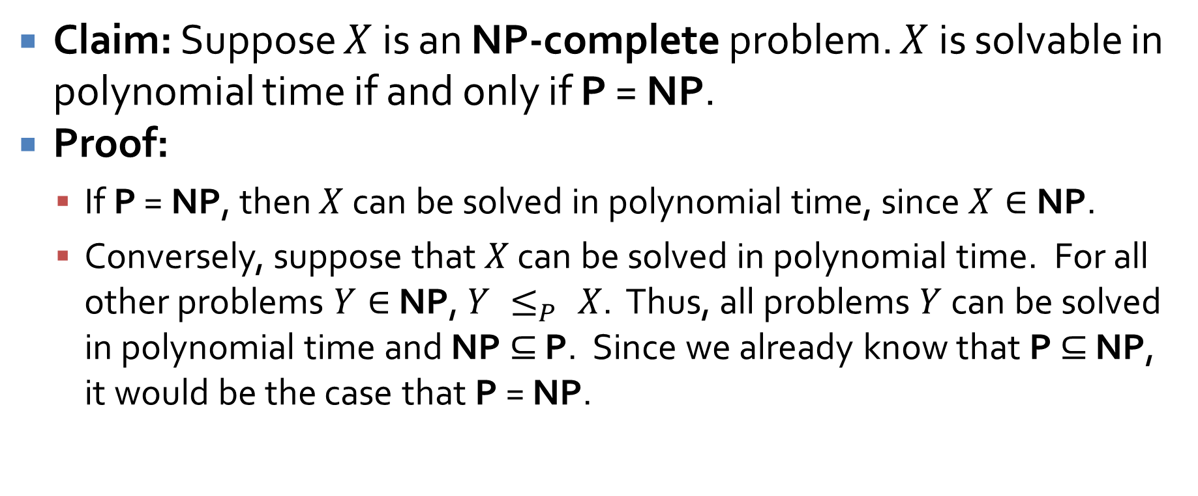
An important consequence
Claim: Suppose $X$ is an NP-complete problem. $X$ is solvable in polynomial time if and only if P = NP.
Proof:
  If P = NP, then $X$ can be solved in polynomial time, since $X∈$ NP.
  Conversely, suppose that $X$ can be solved in polynomial time. For all other problems $Y∈$ NP, $Y ≤_{P} X$. Thus, all problems $Y$ can be solved in polynomial time and NP $⊆$ P. Since we already know that P $⊆$ NP, it would be the case that P = NP.

Slide 44
NP-complete problems
Circuit satisfiability
3-SAT
Independent set
Vertex cover
Set cover
Traveling salesman problem
Hamiltonian cycle
Hamiltonian path
Graph coloring
Subset sum
Knapsack

Slide 45
Approximation Algorithms

Slide 46
Load balancing
You have $m$ machines $M_{1}, M_{2},…,M_{m}$
You have $n$ jobs
Each job $j$ has a processing time $t_{j}$
We can assign jobs $A(i)$ to machine $M_{i}$
The total time that $M_{i}$ needs to work is:
$$T_{i}=\sum_{j∈A(i)}{t_{j}}$$
We want to minimize the makespan, which is just the longest $T_{i}$
In other words, we want the last machine running to stop running as early as possible
Unfortunately, doing so in NP-hard

Slide 47
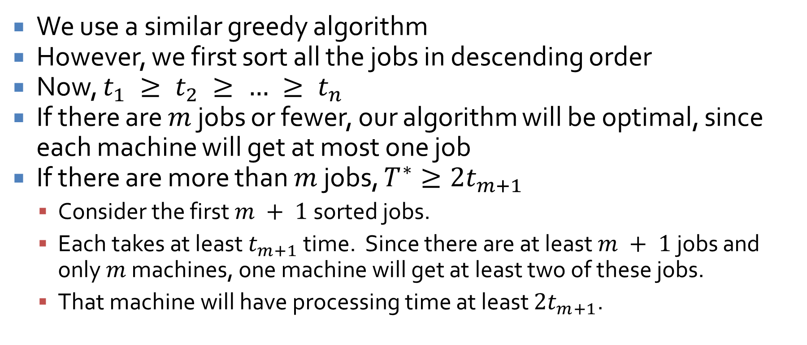
Improved approximation algorithm
We use a similar greedy algorithm
However, we first sort all the jobs in descending order
Now, $t_{1} ≥ t_{2} ≥ … ≥ t_{n}$
If there are $m$ jobs or fewer, our algorithm will be optimal, since each machine will get at most one job
If there are more than $m$ jobs, $T^{∗}≥2t_{m+1}$
  Consider the first $m + 1$ sorted jobs.
  Each takes at least $t_{m+1}$ time. Since there are at least $m + 1$ jobs and only $m$ machines, one machine will get at least two of these jobs.
  That machine will have processing time at least $2t_{m+1}$.

Slide 48
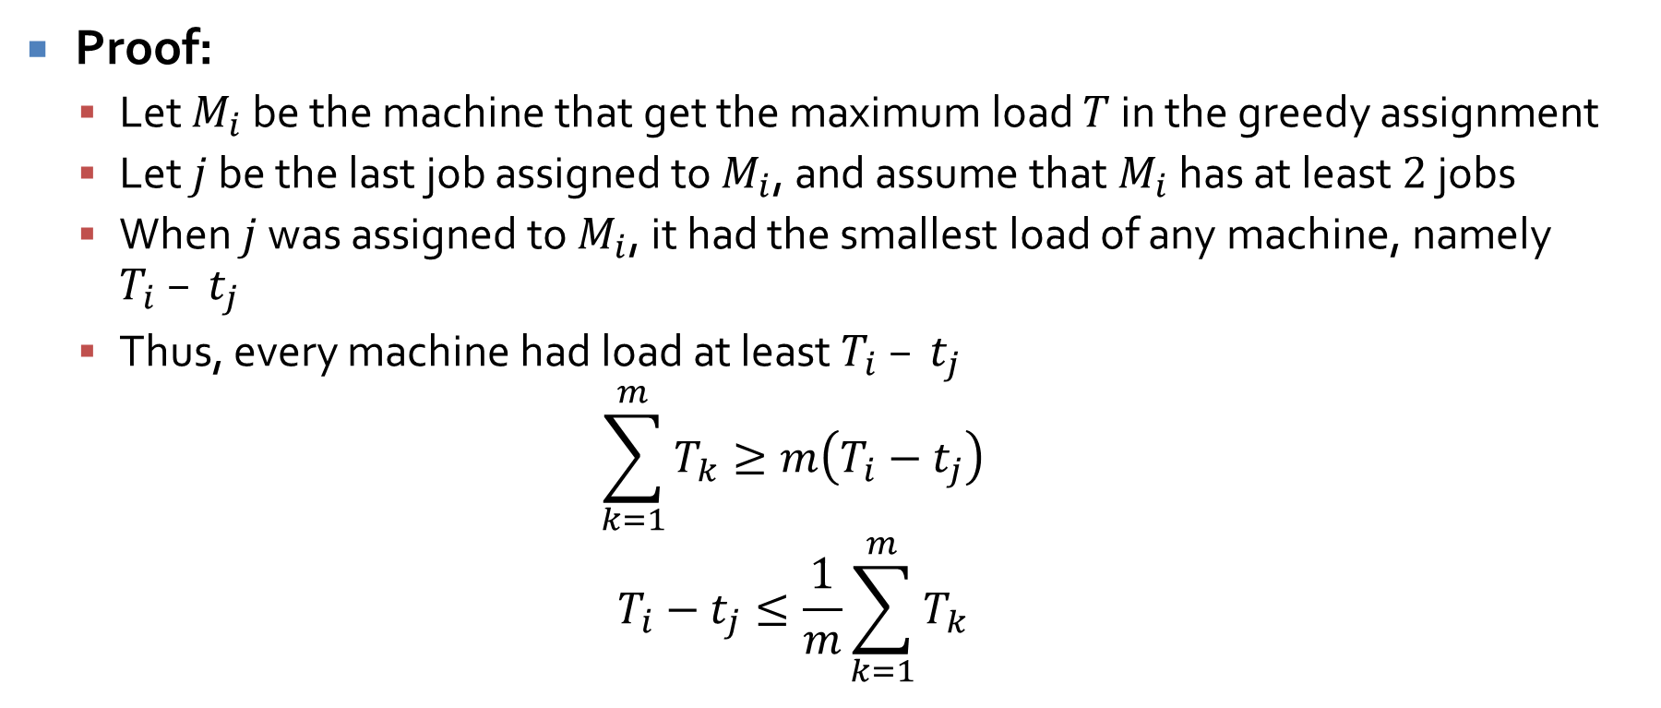
Sorted greedy algorithm gets a makespan $T≤\frac{3}{2}T^{∗}$
Proof:
  Let $M_{i}$ be the machine that get the maximum load $T$ in the greedy assignment
  Let $j$ be the last job assigned to $M_{i}$, and assume that $M_{i}$ has at least $2$ jobs
  When $j$ was assigned to $M_{i}$, it had the smallest load of any machine, namely $T_{i} – t_{j}$
  Thus, every machine had load at least $T_{i} – t_{j}$
  $$\sum_{k=1}^{m}{T_{k}}≥m\left(T_{i}−t_{j}\right)$$
  $$T_{i}−t_{j}≤\frac{1}{m}\sum_{k=1}^{m}{T_{k}}$$

Slide 49
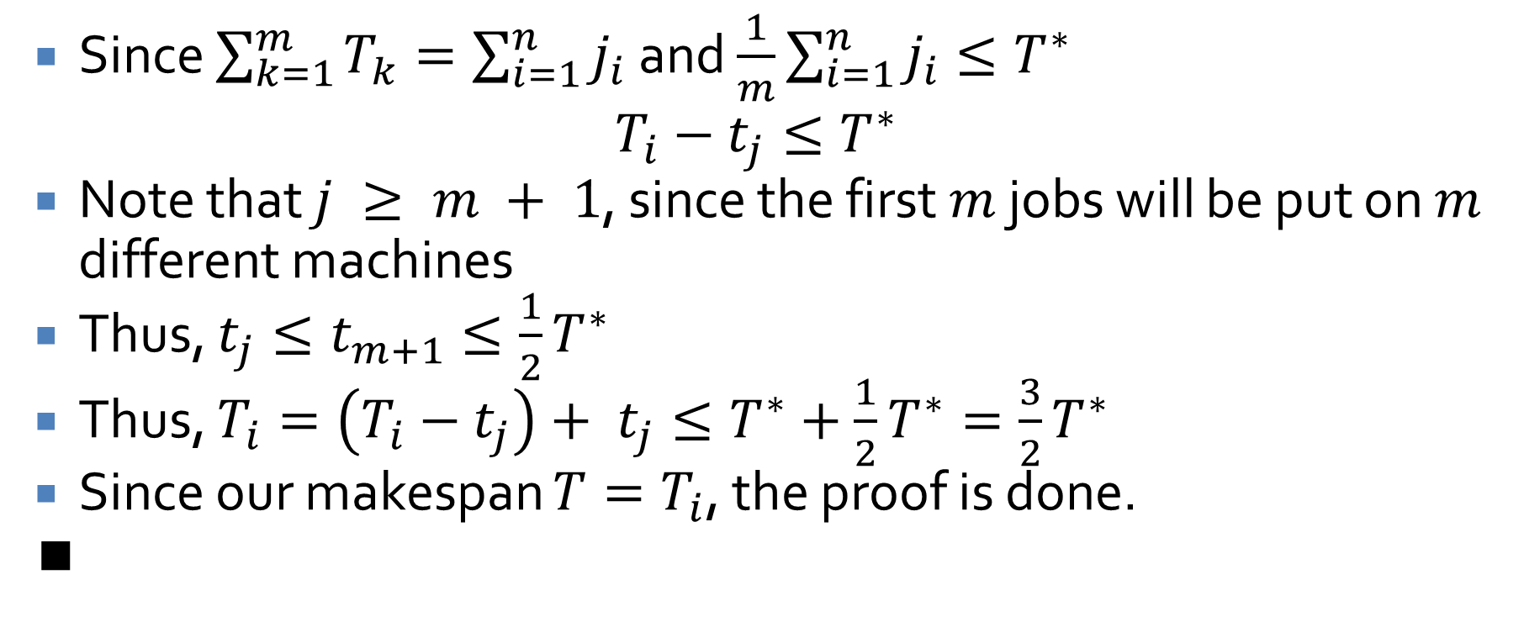
Proof continued
Since $\sum_{k=1}^{m}{T_{k}}=\sum_{i=1}^{n}{j_{i}}$ and $\frac{1}{m}\sum_{i=1}^{n}{j_{i}}≤T^{∗}$
$$T_{i}−t_{j}≤T^{∗}$$
Note that $j ≥ m + 1$, since the first $m$ jobs will be put on $m$ different machines
Thus, $t_{j}≤t_{m+1}≤\frac{1}{2}T^{∗}$
Thus, $T_{i}=\left(T_{i}−t_{j}\right)+ t_{j}≤T^{∗}+\frac{1}{2}T^{∗}=\frac{3}{2}T^{∗}$
Since our makespan $T=T_{i}$, the proof is done.
∎

Slide 50
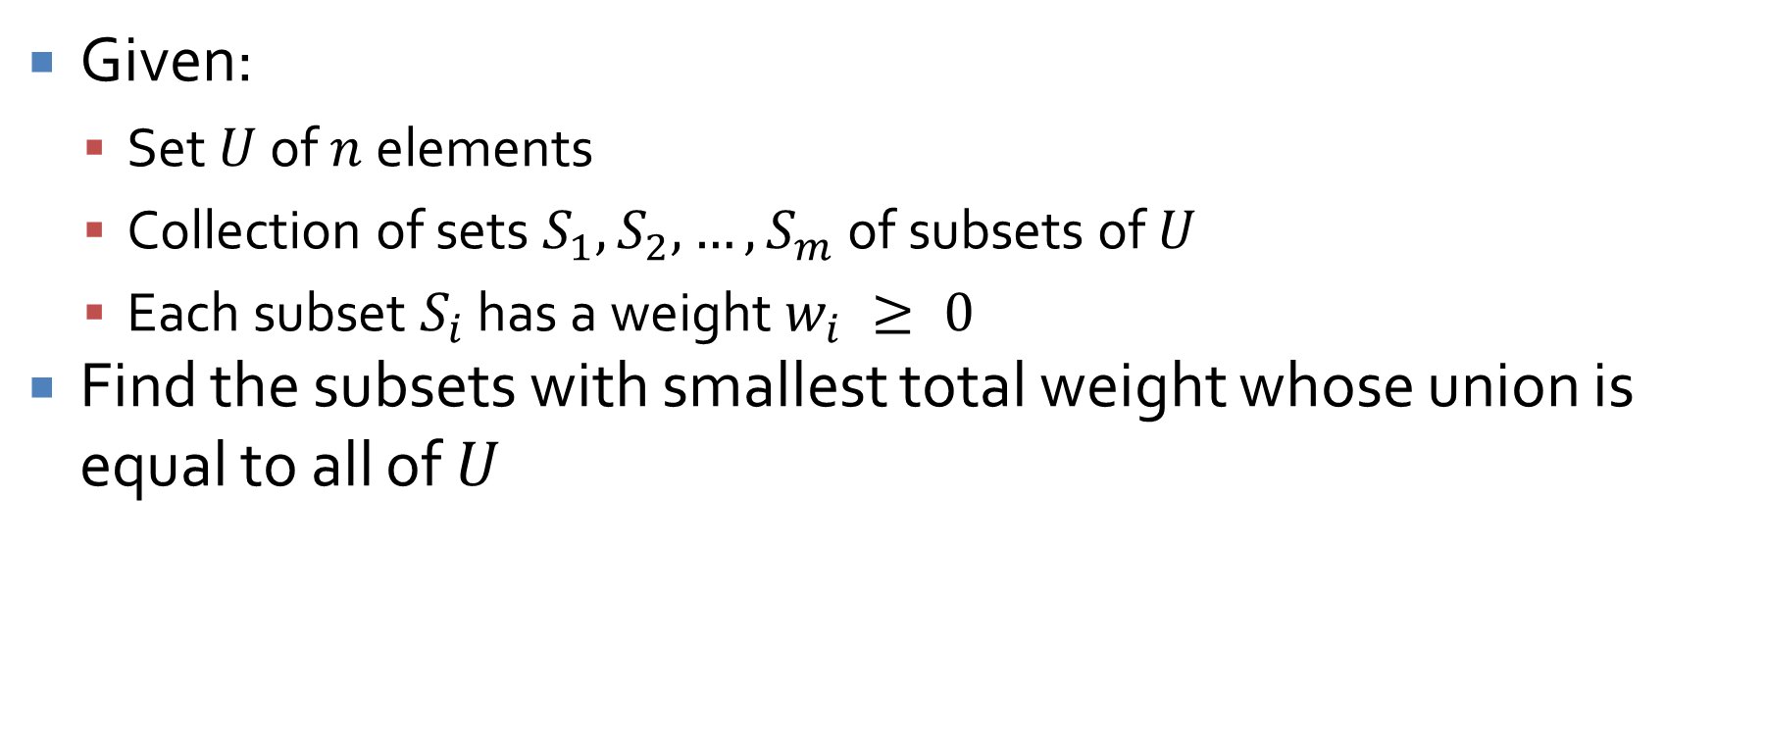
Set cover (optimization version)
Given:
  Set $U$ of $n$ elements
  Collection of sets $S_{1}, S_{2},…, S_{m}$ of subsets of $U$
  Each subset $S_{i}$ has a weight $w_{i} ≥ 0$
Find the subsets with smallest total weight whose union is equal to all of $U$

Slide 51
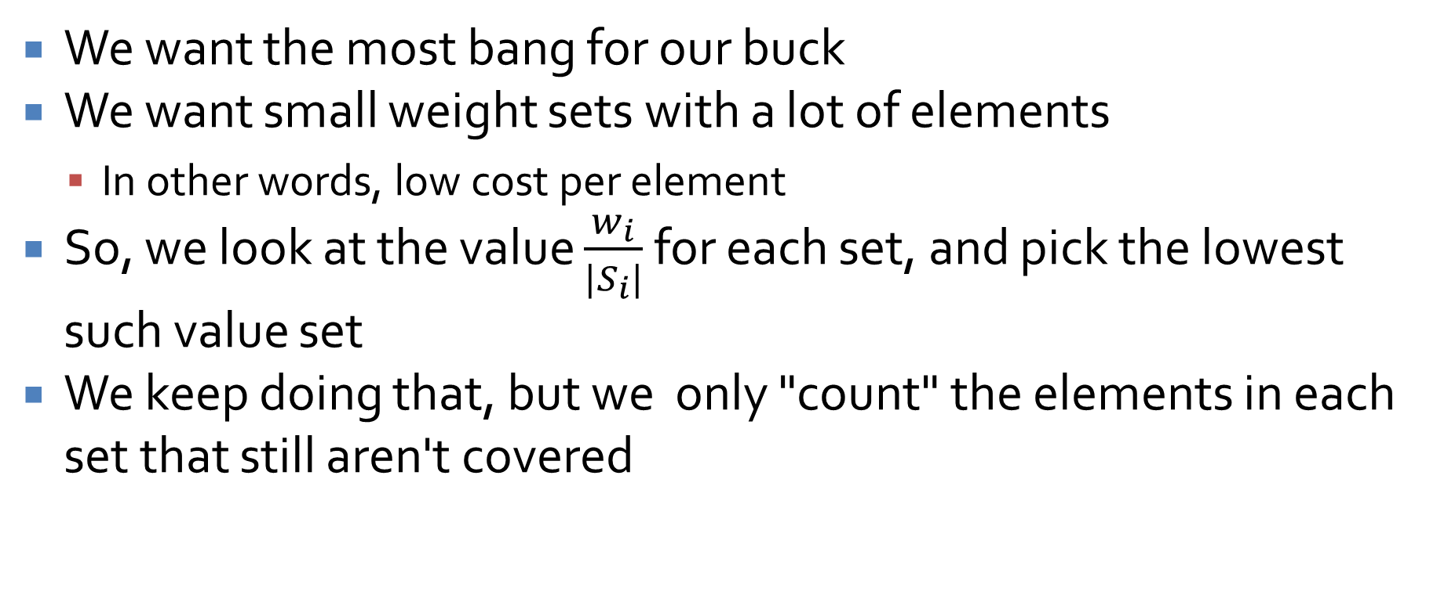
Algorithm design
We want the most bang for our buck
We want small weight sets with a lot of elements
  In other words, low cost per element
So, we look at the value $\frac{w_{i}}{|S_{i}|}$ for each set, and pick the lowest such value set
We keep doing that, but we only "count" the elements in each set that still aren't covered

Slide 52
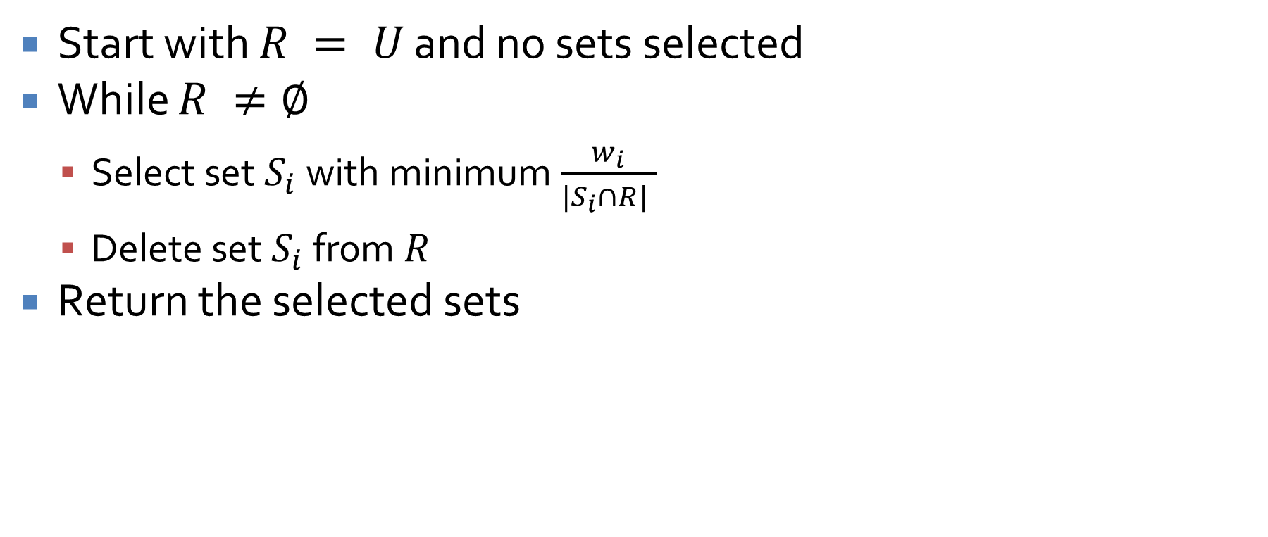
Greedy set cover algorithm
Start with $R = U$ and no sets selected
While $R ≠∅$
  Select set $S_{i}$ with minimum $\frac{w_{i}}{|S_{i}∩R| }$
  Delete set $S_{i}$ from $R$
Return the selected sets

Slide 53
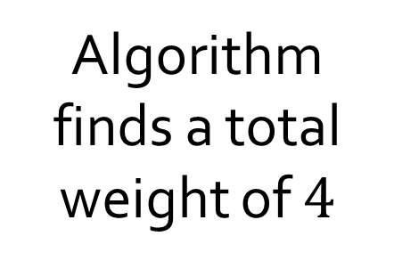






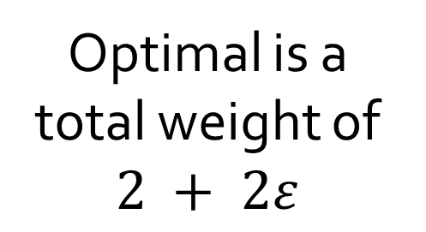
Set cover example
$$1 + ε$$
$$1 + ε$$
Algorithm finds a total weight of $4$
$$1$$
$$1$$
$$1$$
Optimal is a total weight of $2 + 2ε$
$$1$$

Slide 54
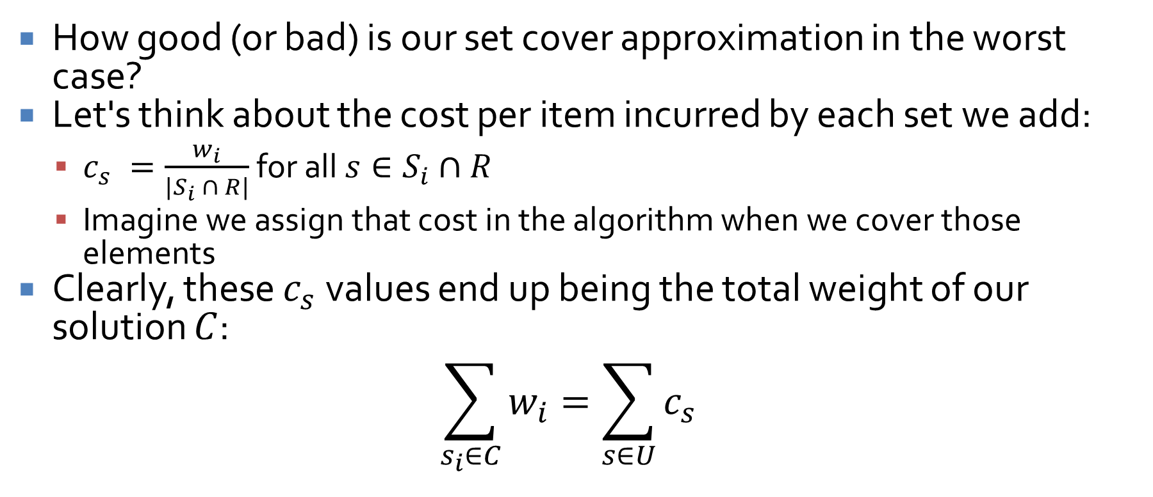
Analysis
How good (or bad) is our set cover approximation in the worst case?
Let's think about the cost per item incurred by each set we add:
  $c_{s} =\frac{w_{i}}{|S_{i} ∩ R|}$ for all $s∈S_{i}∩R$
  Imagine we assign that cost in the algorithm when we cover those elements
Clearly, these $c_{s}$values end up being the total weight of our solution $C$:
$$\sum_{s_{i}∈C}{w_{i}}=\sum_{s∈U}{c_{s}}$$

Slide 55
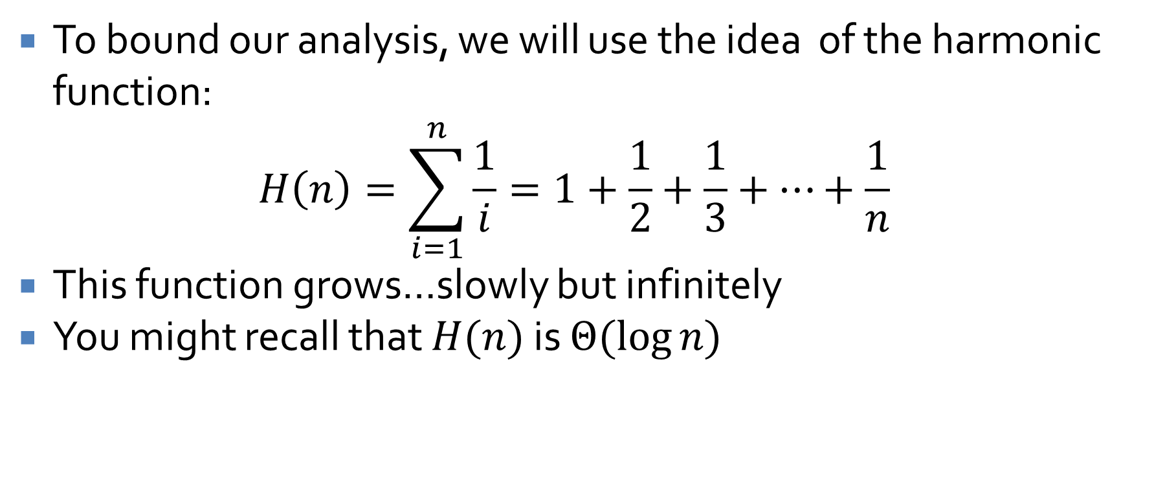
Unfortunately: math
To bound our analysis, we will use the idea of the harmonic function:
$$H\left(n\right)=\sum_{i=1}^{n}{\frac{1}{i}}=1+\frac{1}{2}+\frac{1}{3}+…+\frac{1}{n}$$
This function grows…slowly but infinitely
You might recall that $H(n)$ is $Θ(log⁡n)$

Slide 56
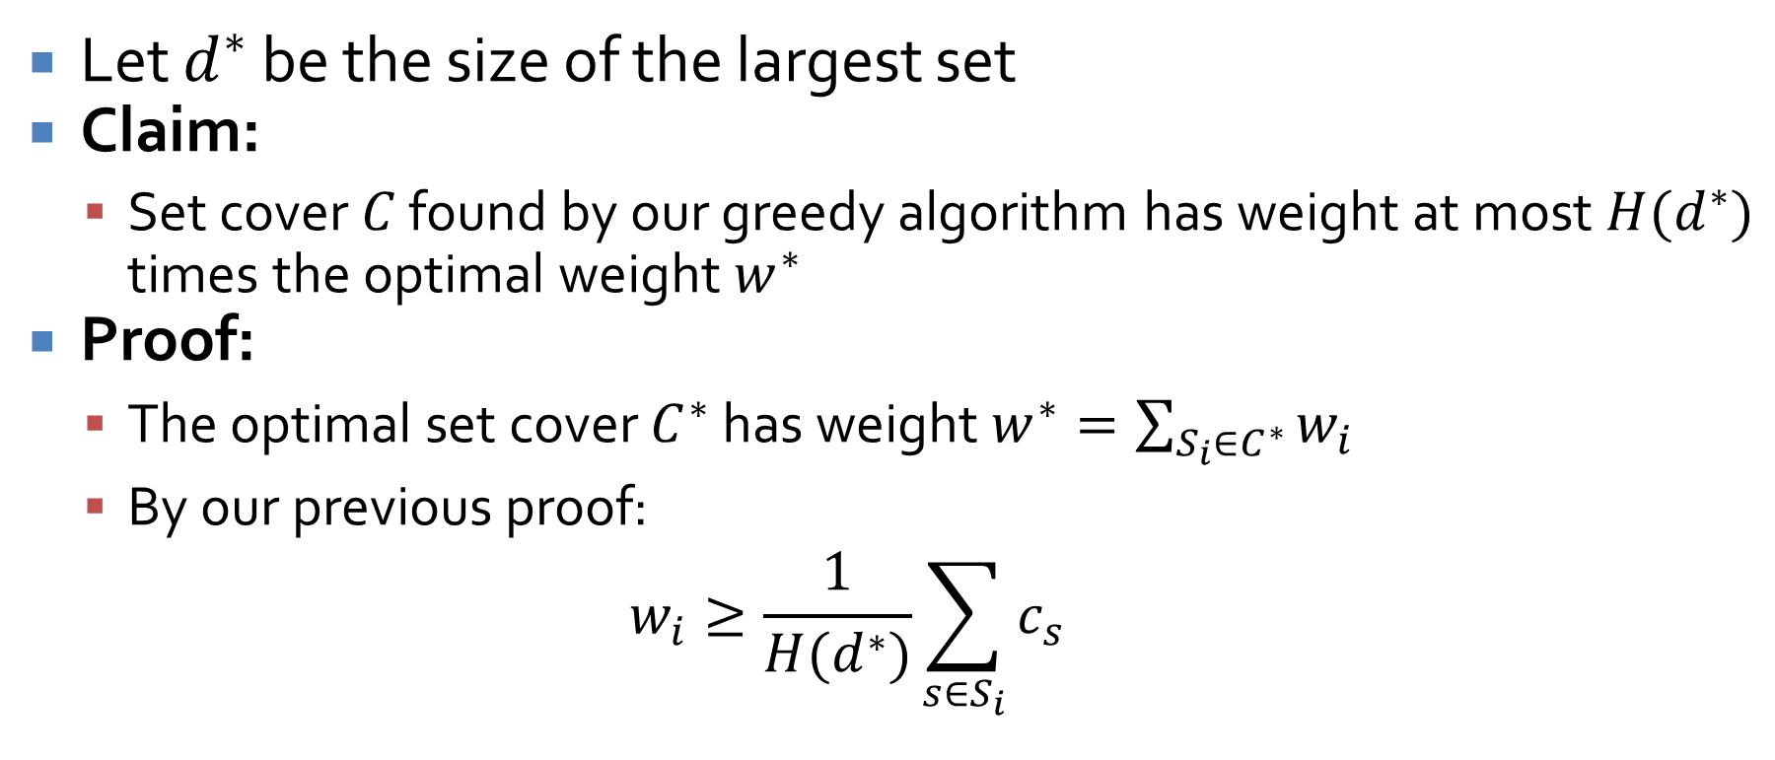
Final approximation bound
Let $d^{∗}$ be the size of the largest set
Claim:
  Set cover $C$ found by our greedy algorithm has weight at most $H(d^{∗})$ times the optimal weight $w^{∗}$
Proof:
  The optimal set cover $C^{∗}$ has weight $w^{∗}=\sum_{S_{i}∈C^{∗}}{w_{i}}$
  By our previous proof:
  $$w_{i}≥\frac{1}{H(d^{∗})}\sum_{s∈S_{i}}{c_{s}}$$

Slide 57
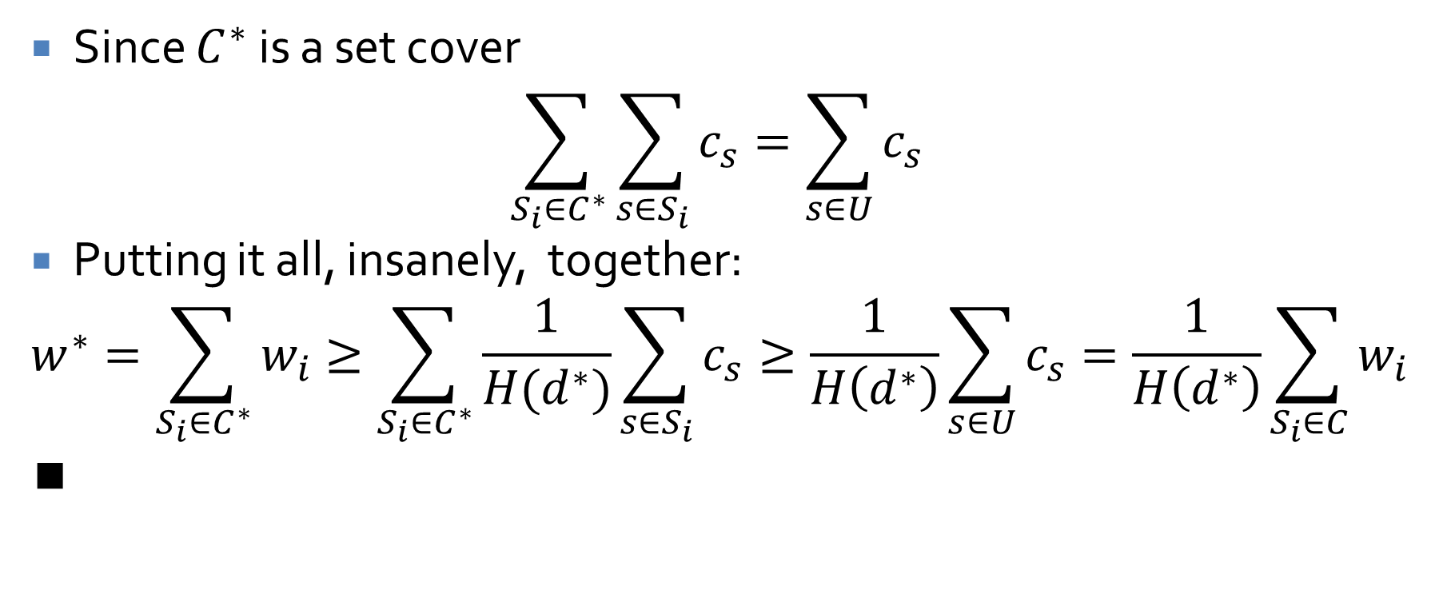
Approximation bound continued
Since $C^{∗}$ is a set cover
$$\sum_{S_{i}∈C^{∗}}{\sum_{s∈S_{i}}{c_{s}}}=\sum_{s∈U}{c_{s}}$$
Putting it all, insanely, together:
$$w^{∗}=\sum_{S_{i}∈C^{∗}}{w_{i}≥\sum_{S_{i}∈C^{∗}}{\frac{1}{H(d^{∗})}\sum_{s∈S_{i}}{c_{s}}}}≥\frac{1}{H\left(d^{∗}\right)}\sum_{s∈U}{c_{s}}=\frac{1}{H\left(d^{∗}\right)}\sum_{S_{i}∈C}{w_{i}}$$
∎

Slide 58
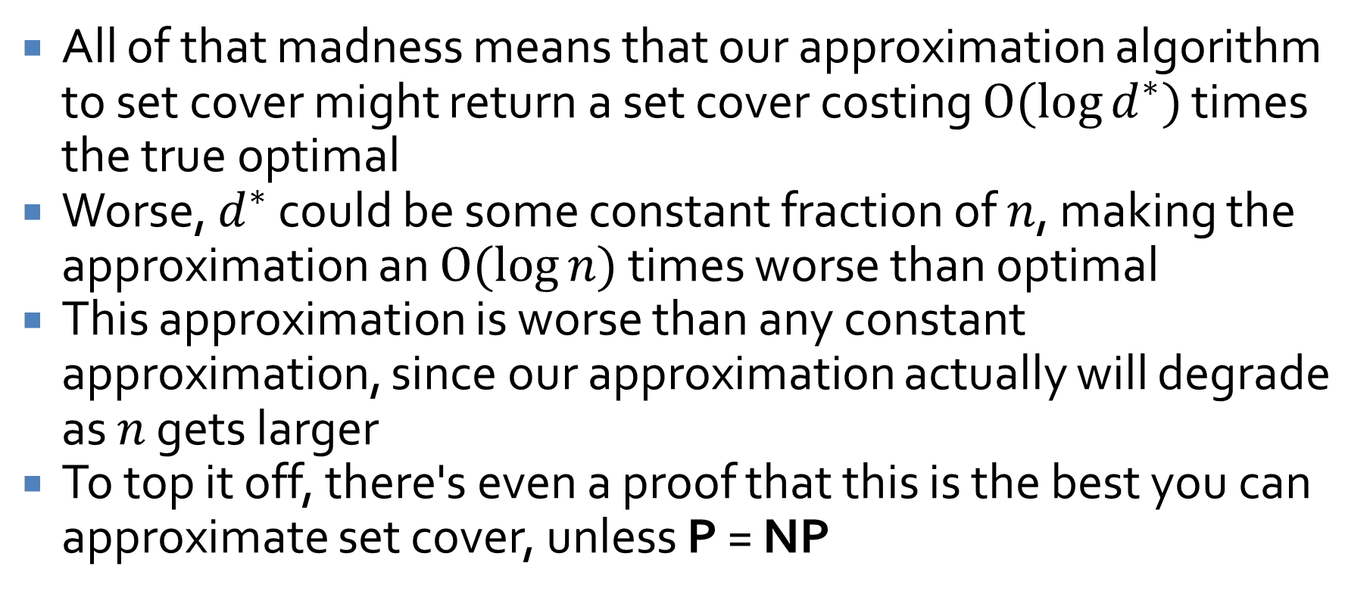
Log approximation
All of that madness means that our approximation algorithm to set cover might return a set cover costing $O(log⁡d^{∗})$ times the true optimal
Worse, $d^{∗}$ could be some constant fraction of $n$, making the approximation an $O(log⁡n)$ times worse than optimal
This approximation is worse than any constant approximation, since our approximation actually will degrade as $n$ gets larger
To top it off, there's even a proof that this is the best you can approximate set cover, unless P = NP

Slide 59
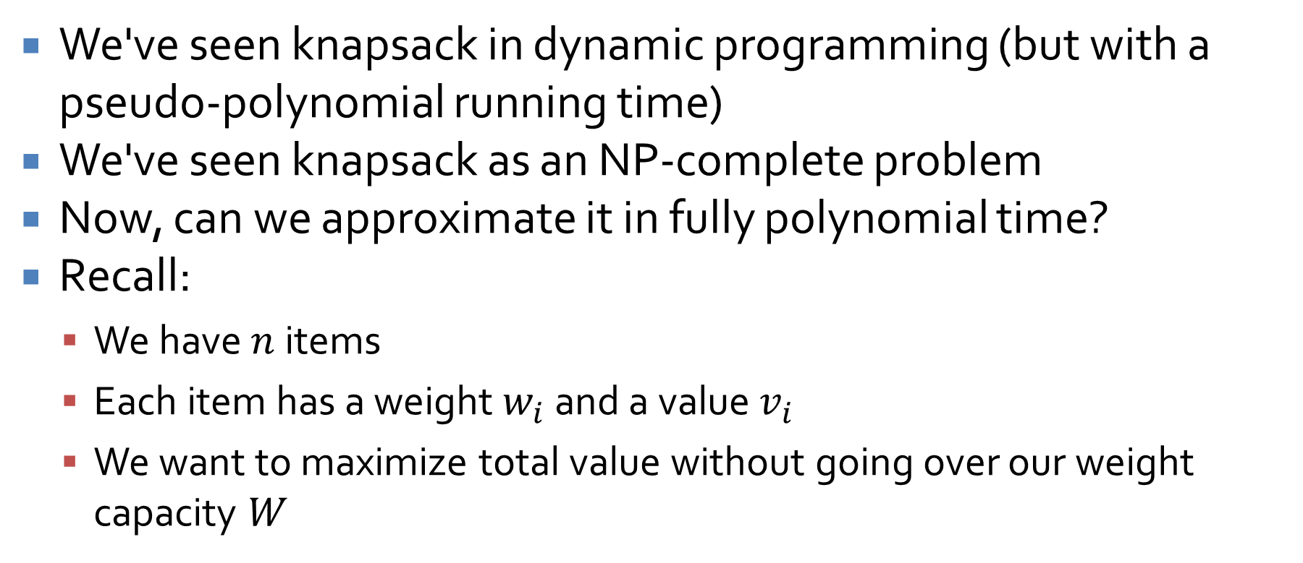
Knapsack
We've seen knapsack in dynamic programming (but with a pseudo-polynomial running time)
We've seen knapsack as an NP-complete problem
Now, can we approximate it in fully polynomial time?
Recall:
  We have $n$ items
  Each item has a weight $w_{i}$ and a value $v_{i}$
  We want to maximize total value without going over our weight capacity $W$

Slide 60
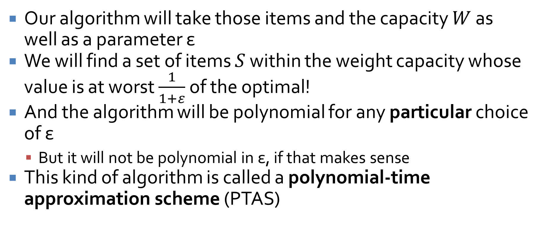
The best approximation yet!
Our algorithm will take those items and the capacity $W$ as well as a parameter ε
We will find a set of items $S$ within the weight capacity whose value is at worst $\frac{1}{1+ε}$ of the optimal!
And the algorithm will be polynomial for any particular choice of ε
  But it will not be polynomial in ε, if that makes sense
This kind of algorithm is called a polynomial-time approximation scheme (PTAS)

Slide 61
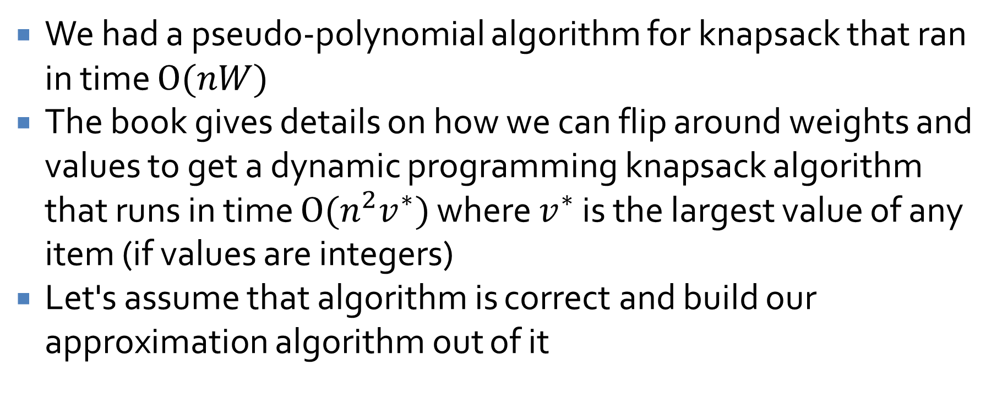
Algorithm design
We had a pseudo-polynomial algorithm for knapsack that ran in time $O(nW)$
The book gives details on how we can flip around weights and values to get a dynamic programming knapsack algorithm that runs in time $O(n^{2}v^{∗})$ where $v^{∗}$ is the largest value of any item (if values are integers)
Let's assume that algorithm is correct and build our approximation algorithm out of it

Slide 62
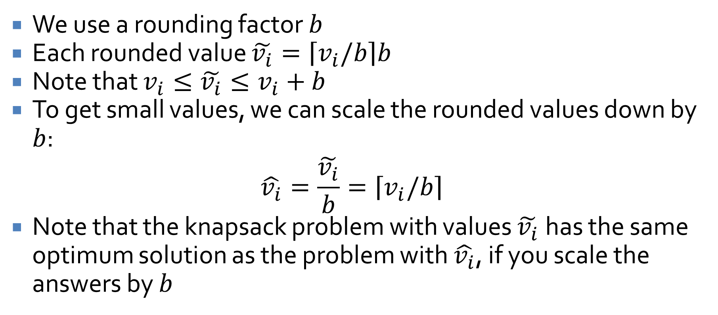
Rounding notation
We use a rounding factor $b$
Each rounded value $\tilde{v_{i}}=\left\lceil v_{i}/b\right\rceil b$
Note that $v_{i}≤\tilde{v_{i}}≤v_{i}+b$
To get small values, we can scale the rounded values down by $b$:
$$\hat{v_{i}}=\frac{\tilde{v_{i}}}{b}=\left\lceil v_{i}/b\right\rceil$$
Note that the knapsack problem with values $\tilde{v_{i}}$has the same optimum solution as the problem with $\hat{v_{i}}$, if you scale the answers by $b$

Slide 63

Approximate knapsack algorithm
Knapsack-Approx(ε)
  Set $b = \frac{ε}{2n} \max_{i}{v_{i}}$
  Solve the Knapsack problem with values $\hat{v_{i}}$
  Return the set $S$ of items found

Slide 64
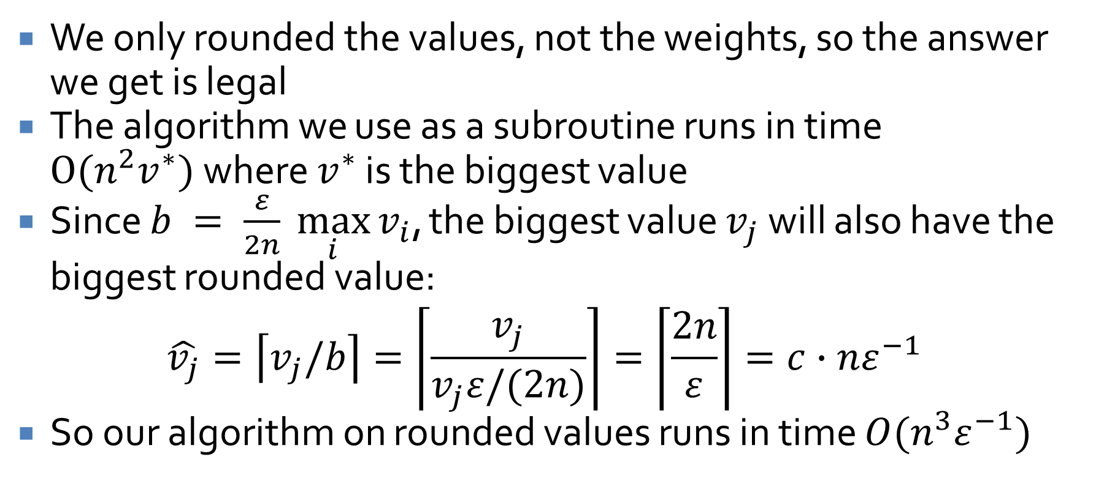
Approximation running time
We only rounded the values, not the weights, so the answer we get is legal
The algorithm we use as a subroutine runs in time $O(n^{2}v^{∗})$where $v^{∗}$ is the biggest value
Since $b = \frac{ε}{2n} \max_{i}{v_{i}}$, the biggest value $v_{j}$ will also have the biggest rounded value:
$$\hat{v_{j}}=\left\lceil v_{j}/b\right\rceil =\left\lceil \frac{v_{j}}{v_{j}ε/(2n)}\right\rceil =\left\lceil \frac{2n}{ε}\right\rceil =c∙nε^{−1}$$
So our algorithm on rounded values runs in time $O(n^{3}ε^{−1})$

Slide 65
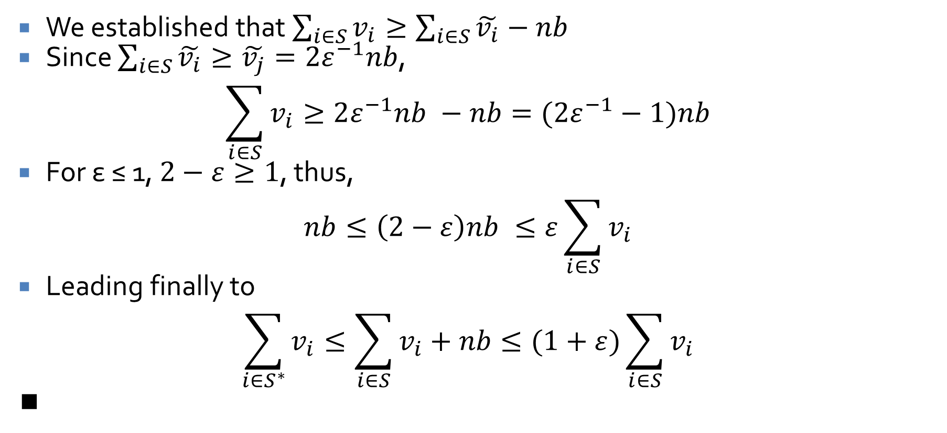
Approximation bound
We established that $\sum_{i∈S}{v_{i}}≥\sum_{i∈S}{\tilde{v_{i}}}−nb$
Since $\sum_{i∈S}{\tilde{v_{i}}}≥\tilde{v_{j}}=2ε^{−1}nb$,
$$\sum_{i∈S}{v_{i}}≥2ε^{−1}nb −nb=(2ε^{−1}−1)nb$$
For ε ≤ 1, $2−ε≥1$, thus,
$$nb≤\left(2−ε\right)nb ≤ε\sum_{i∈S}{v_{i}}$$
Leading finally to
$$\sum_{i∈S^{∗}}{v_{i}}≤\sum_{i∈S}{v_{i}+nb}≤(1+ε)\sum_{i∈S}{v_{i}}$$
∎

Slide 66
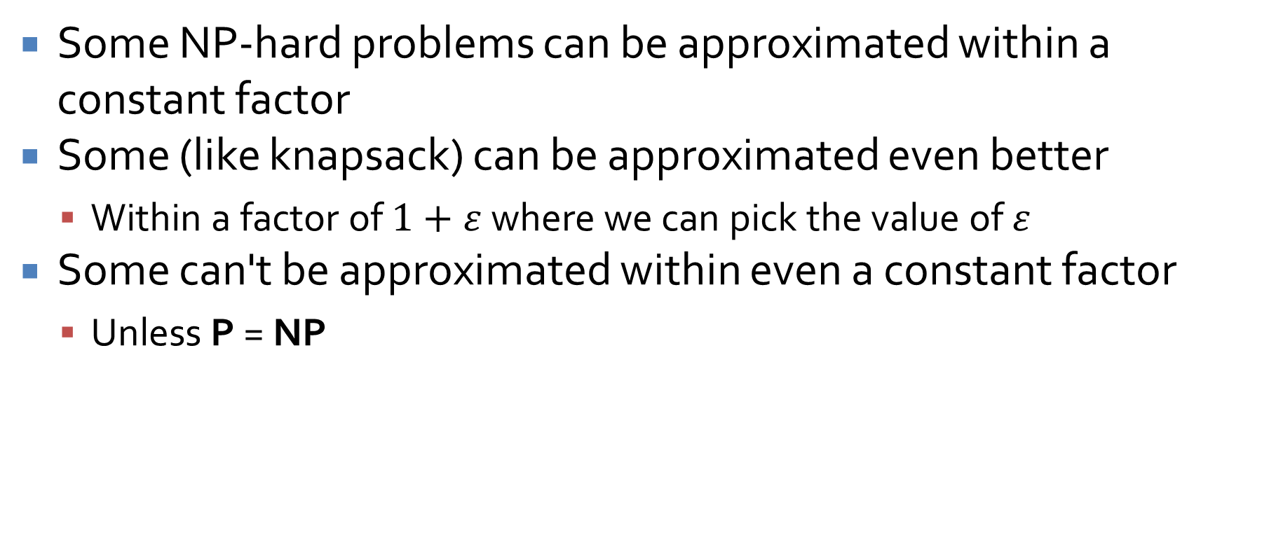
Approximation algorithms
Some NP-hard problems can be approximated within a constant factor
Some (like knapsack) can be approximated even better
  Within a factor of $1+ε$ where we can pick the value of $ε$
Some can't be approximated within even a constant factor
  Unless P = NP

Slide 67
Upcoming

Slide 68
Next time…
There is no next time!

Slide 69
Reminders
Finish Assignment 7
  Due tonight by midnight!
Review chapters 1 – 8 and 11
Final exam:
  Friday, April 24, 2026
  10:15 a.m. – 12:15 p.m.

